Slide 1
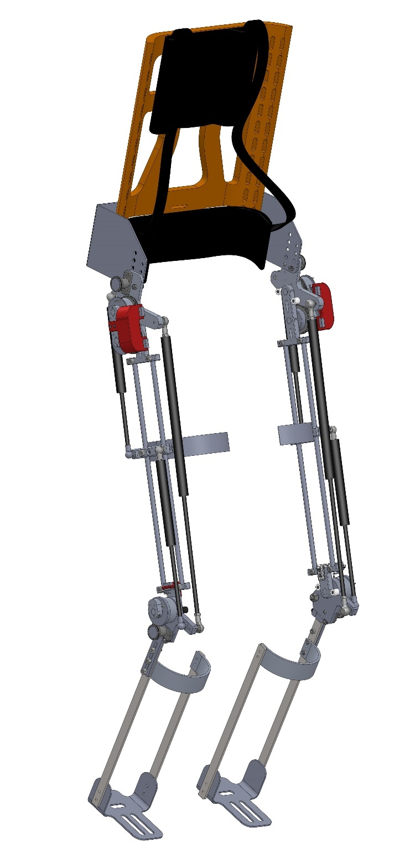
Design of a muscle-powered walking exoskeleton for people with spinal cord injury
Vikram Katti
Advisor - Prof. William Durfee
Department of Mechanical Engineering
University of Minnesota
Notes:
I’ll be presenting my thesis which is titled

Slide 2
Outline
Background
Concept description
Design
Evaluation
Notes:
First, I’ll give you a brief background on sci
Then I’ll describe the concept of our device
Then I’ll delve into the design and finally I’ll talk about the evaluation tests and their results

Slide 3
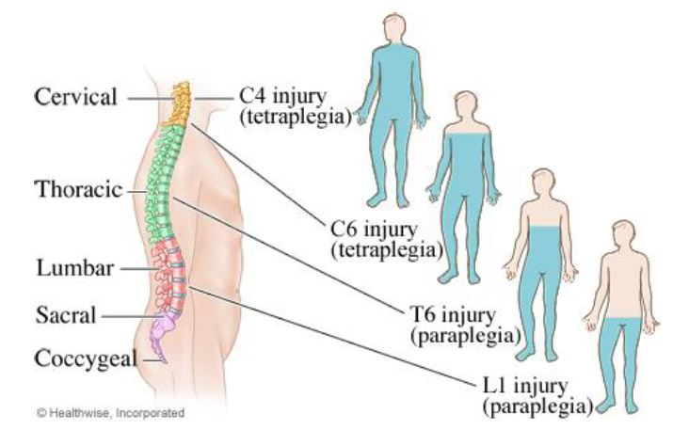
What is spinal cord injury (SCI)?
282,000 people in the US have Spinal Cord Injury (SCI) [1]
17000 new cases per year of people with SCI [1]
Level of SCI [2]
Causes of SCI [3]
Notes:
The spinal cord is responsible for transmission of nerve signals from the motor cortex of the brain to all parts of the body, and from the sensory neurons to the sensory cortex.
Spinal cord has 5 segments, CTLSC, as shown in the image on the left. Damage to any part of the spinal cord is known as spinal cord injury (SCI). It can lead to significant loss of sensory and motor functions below the level of injury.
The severity of the injury is known as “the completeness” and can be categorized as complete if all sensory and motor function is lost below the level of injury or incomplete if there exists some sensory/ motor function below the level of injury.
Vehicular accidents are the most common cause for sci. falls, voilece etc are some of the other causes.

Slide 4
Need
51% of people with SCI identified walking as first choice for a technology application [1]
Notes:
Therefore, there is a need for a device that can restore walking in people with SCI

Slide 5
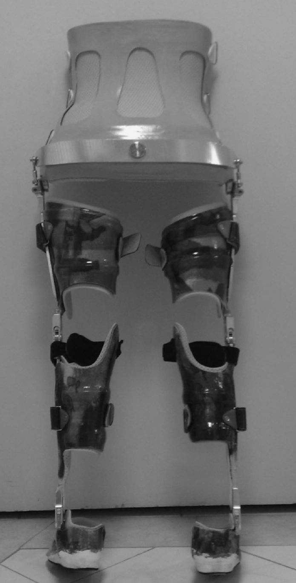
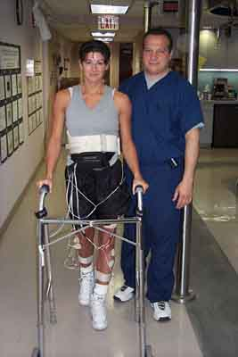
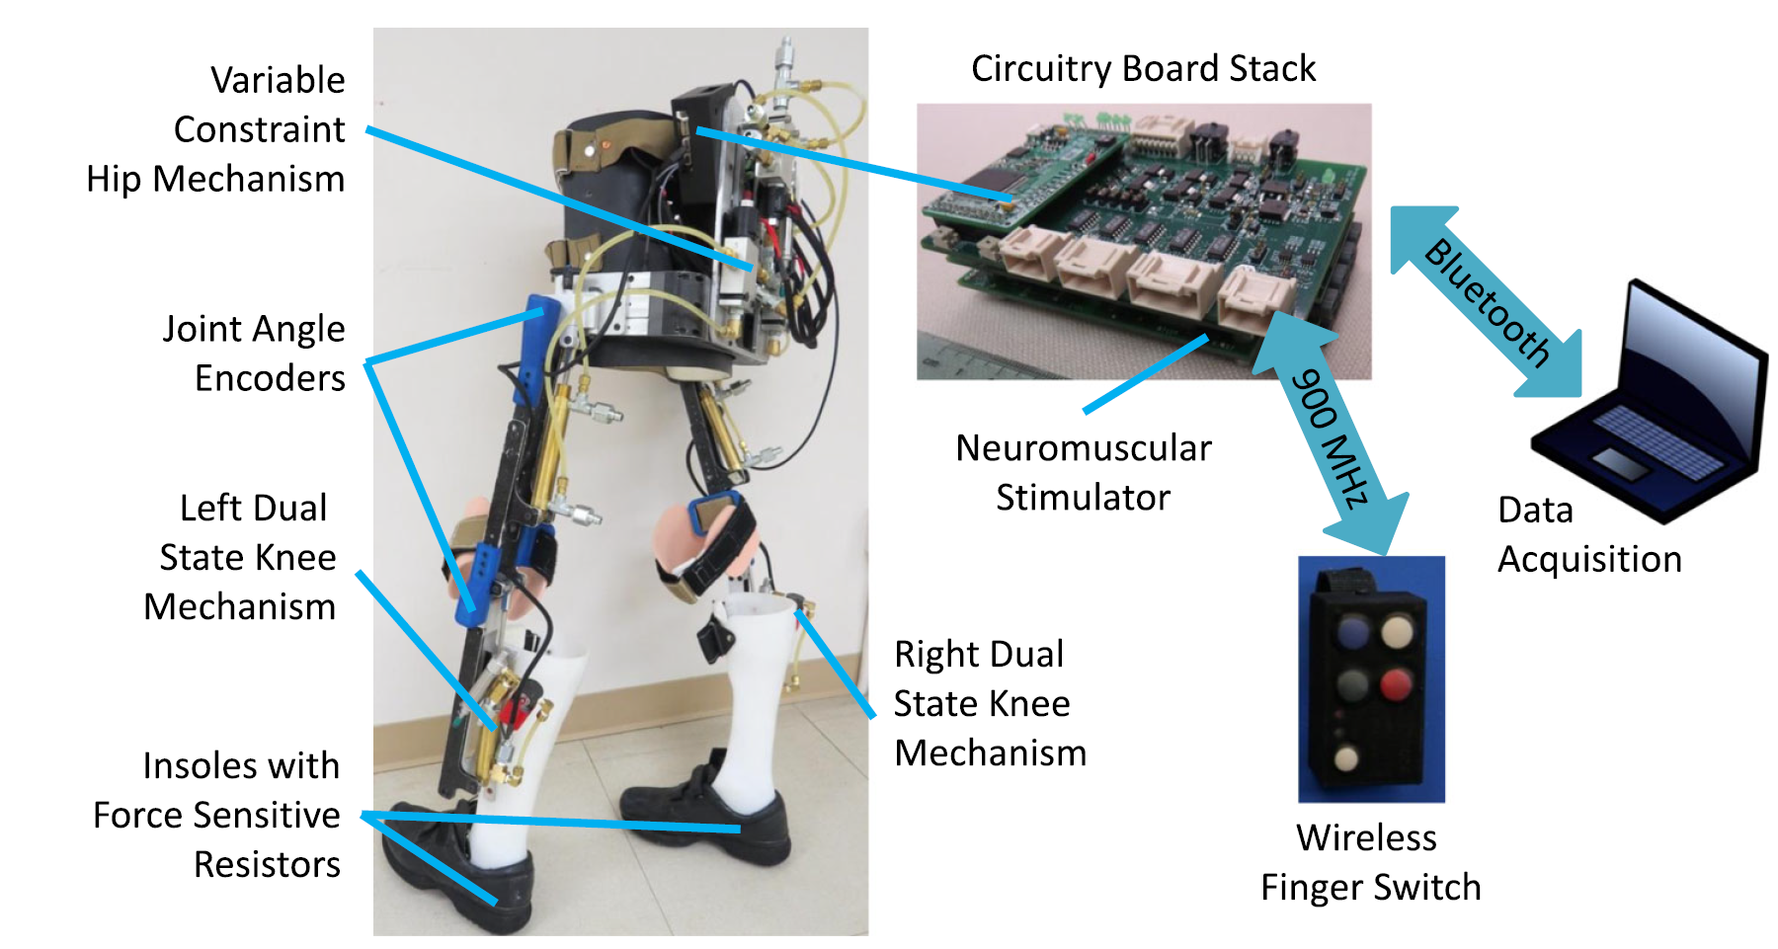
Non-motorized approach
Muscle stimulation device [1]
Passive orthosis [2]
Hybrid device [3]
Notes:
Many devices have been developed to address this need and they can be categorized as pure FES devices, Passive orthoses, Hybrid devices, and motorized devices
In SCI the connection between nerve fibres and muscles still remains intact which means that sending electrical pulses from an external source will make the muscles contract and this technique is known as FES.
The image on the left shows Parastep which is the only FDA approved FES device that uses 4 to 6 channels of surface stimulation to achieve gait.
Shown in the middle is a reciprocating gait orthosis which is a passive device used to modify the structural and functional characteristics of the neuromuscular and skeletal system. It provide assistance by locking the joints thereby enabling people with SCI to stand and by coupling the movements of the two legs to achieve stepping.
A hybrid system combine electrical stimulation of muscles with a lower limb orthosis where e stim is the energy source and the othosis provides support. The image on the right shows a hybrid system that uses implanted electodes to stimulate the muscles and was developed by researchers at CWRU.

Slide 6
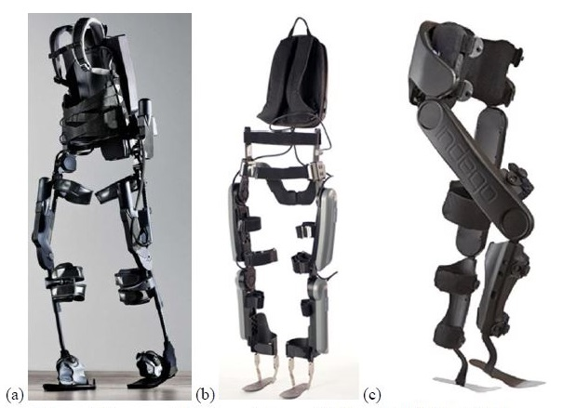
Motorized exoskeletons
(a) Ekso [1] (b) ReWalk [2] (c) Indego [3]
Notes:
Motorized exosketons such as Ekso Indego ReWalk use electric motors at the hip and knee joints. They have some form of controller to initiate and control the stepping motions and a lithium-ion battery pack for untethered power

Slide 7
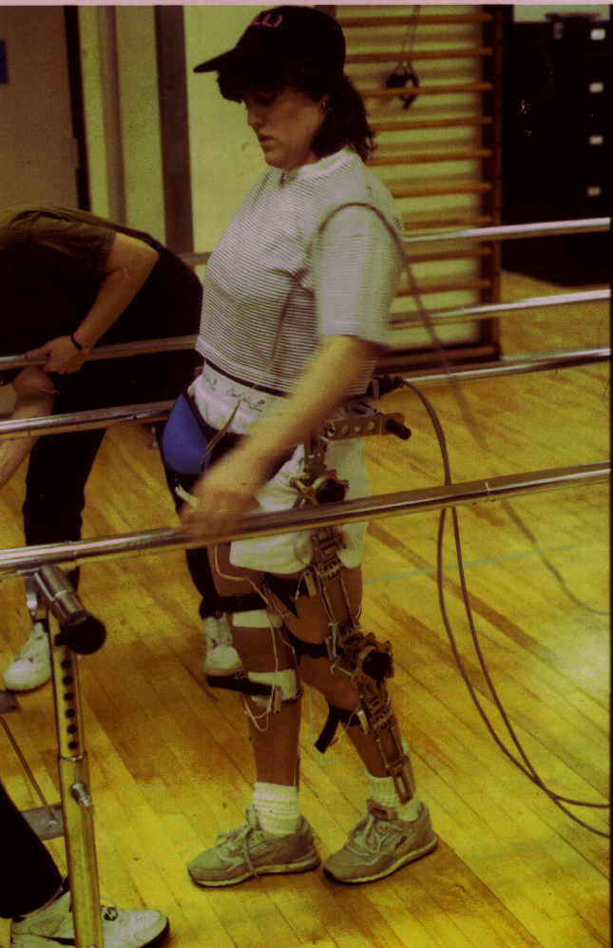
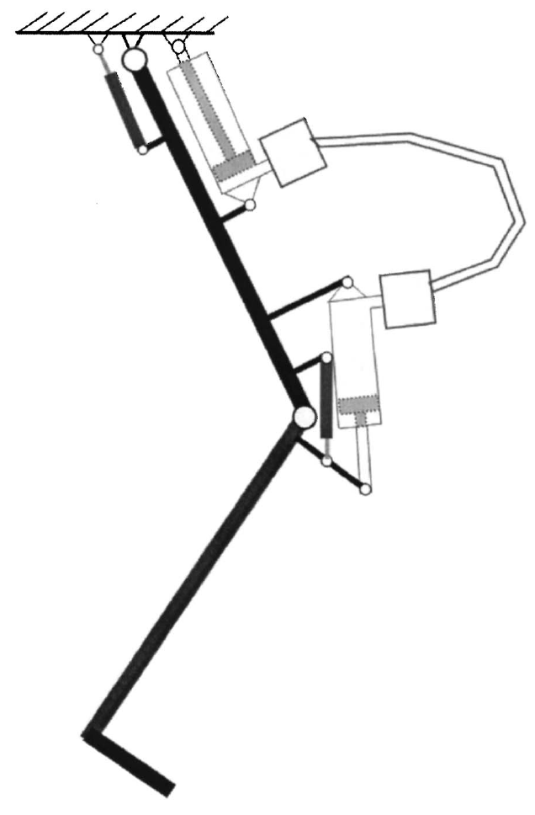
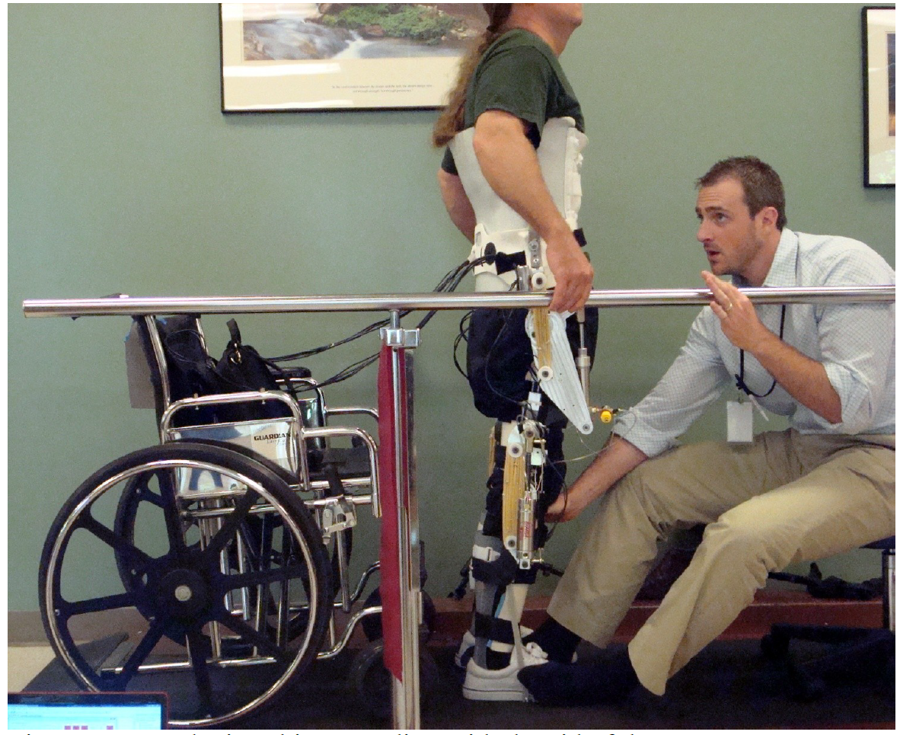
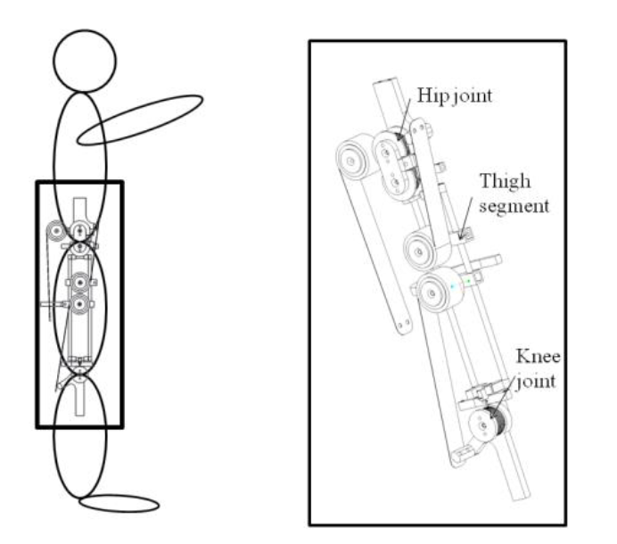
Project background
1st gen energy storing orthosis (ESO) (Rivard [2])
Controlled brake orthosis (Goldfarb [1])
2nd gen ESO (Kangude [3])
3rd gen ESO (Boughner [4])
Notes:
Our lab has worked on several versions of a hybrid device that enable people with SCI to stand and walk for some time for exercise.
Controlled brake orthosis used 4 channels of stimulation and magnetic particle brakes at the joints. It did not assist in forward progression and required significant upper body strength for walking.
The first generation Energy storing orthosis (or the ESO) used a single channel of stimulation is used to capture energy at the knee and then the energy is transferred to the hip to result in forward progression. Gas springs and pneumatics were used as the energy storing elements
The second generation ESO used rubber bands and pneumatics as energy storing elements. In pneumatics, most of the energy is stored in the last stages of compression. This could lead to minimal energy stored.
The third generation ESO designed used constant force springs to overcome the issues related to storing energy in pneumatics.
My work builds on work by previous students in the lab and addresses the need for a muscle-powered device that uses surface stimulation to provide reliable short-range walking

Slide 8
Objectives
Develop a prototype of the functional electrical stimulation- energy storing orthosis (FES-ESO)
Evaluate its performance in one research volunteer with SCI
Notes:
The first objective was to design, fabricate, and bench test a prototype of the FES-ESO
And then to evaluate its performance in a volunteer with SCI

Slide 9
Concept

Slide 10
FES-ESO
Hip spring
Energy transfer spring
Wrap springs as brakes
Knee spring
Notes:
Our idea is to combine FES of a single muscle which is the quadriceps with an energy storing orthosis to achieve gait
The FES-ESO is meant to be an exercise device and not a device for community walking
FES-ESO is meant to enable standing and limited walking as a result of which the users bone health would improve, their muscles will not atrophy, and they would get exercise which is good in general

Slide 11
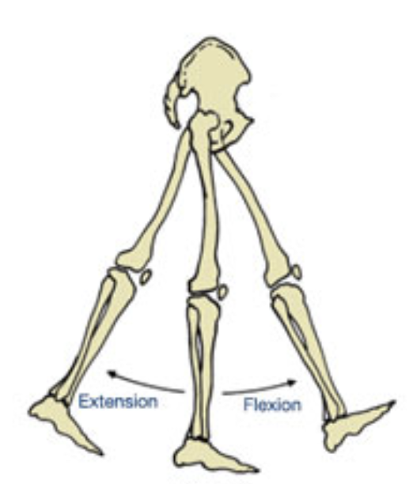
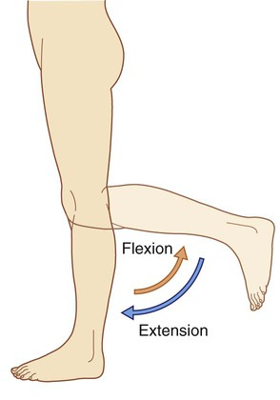
Anatomical terms
Flexion - decreases the angle between two body parts
Extension - increases the angle between two body parts
Hip flexion, extension [1]
Knee flexion, extension [2]
[1] acefitness.org
[2] clinicalgate.com

Slide 12
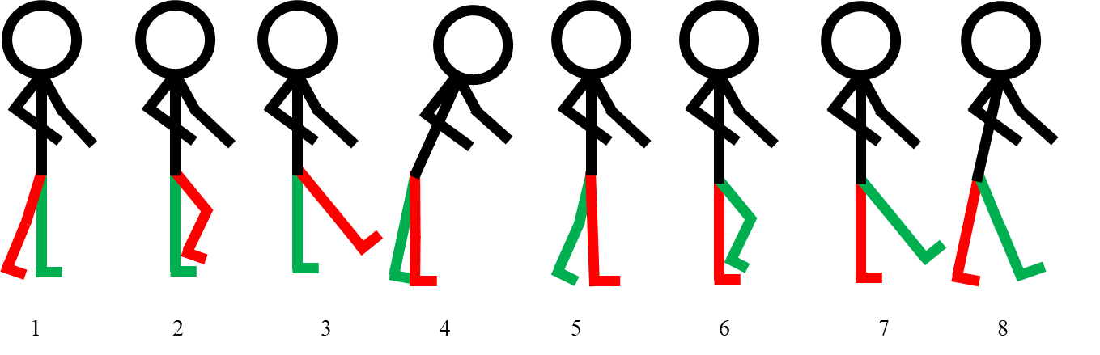
FES-ESO step cycle
ETS
HS
HS
HS
ETS
ETS
KS
KS
KS
KS, ETS compressed
ETS extends at hip, compresses HS
HS extends at hip, KS extends at knee
Notes:
Shown on the left is the stepping sequence of a user walking with the FES-ESO.
If you focus on the right leg colored in red, when the quads are stimulated the knee extends which is shown from 2 to 3. In the figure shown on the right you can see that this motion stores energy in the energy transfer spring ETS and the knee spring KS.
Then the users knee is locked and they fall on to their heel as shown from 3 to 4
The hip is then unlocked causing the ETS to compress the hip spring HS which causes hip extension as shown from 4 to 8
Finally, both the hip and the knee are unlocked. This allows HS to extend at the hip, the KS to extend at the knee causing both the joints to flex as shown from 1 to 2. This cycle is repeated to accomplish gait

Slide 13
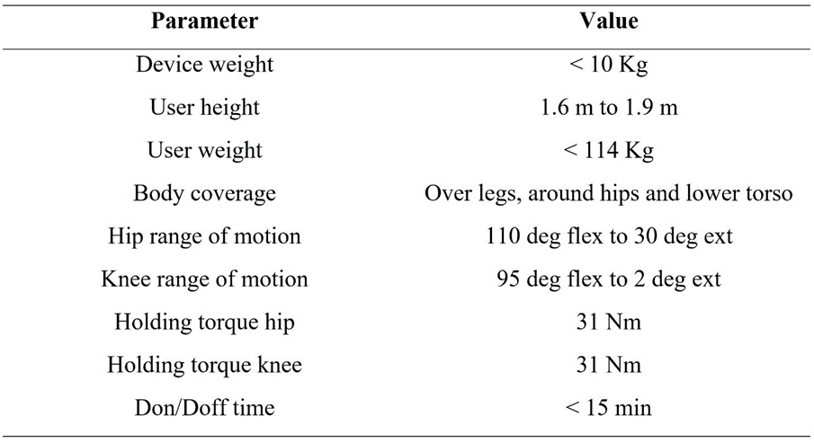
Design requirements
Notes:
Considerably lighter than comm exo , ekso 20kg
Height range – reasonable range of link lengths
Weight – reasonable structural strength without making it too heavy
For support, body is critical to avoid relative motion between the exoskeleton and the users leg
Hip, Knee ROM – enable comfortable sitting position
Holding torques – to prevent collapse
Don/ doff time is less critical for this project as the aim here is to test the feasubility of the concept

Slide 14
Design of FES-ESO

Slide 15
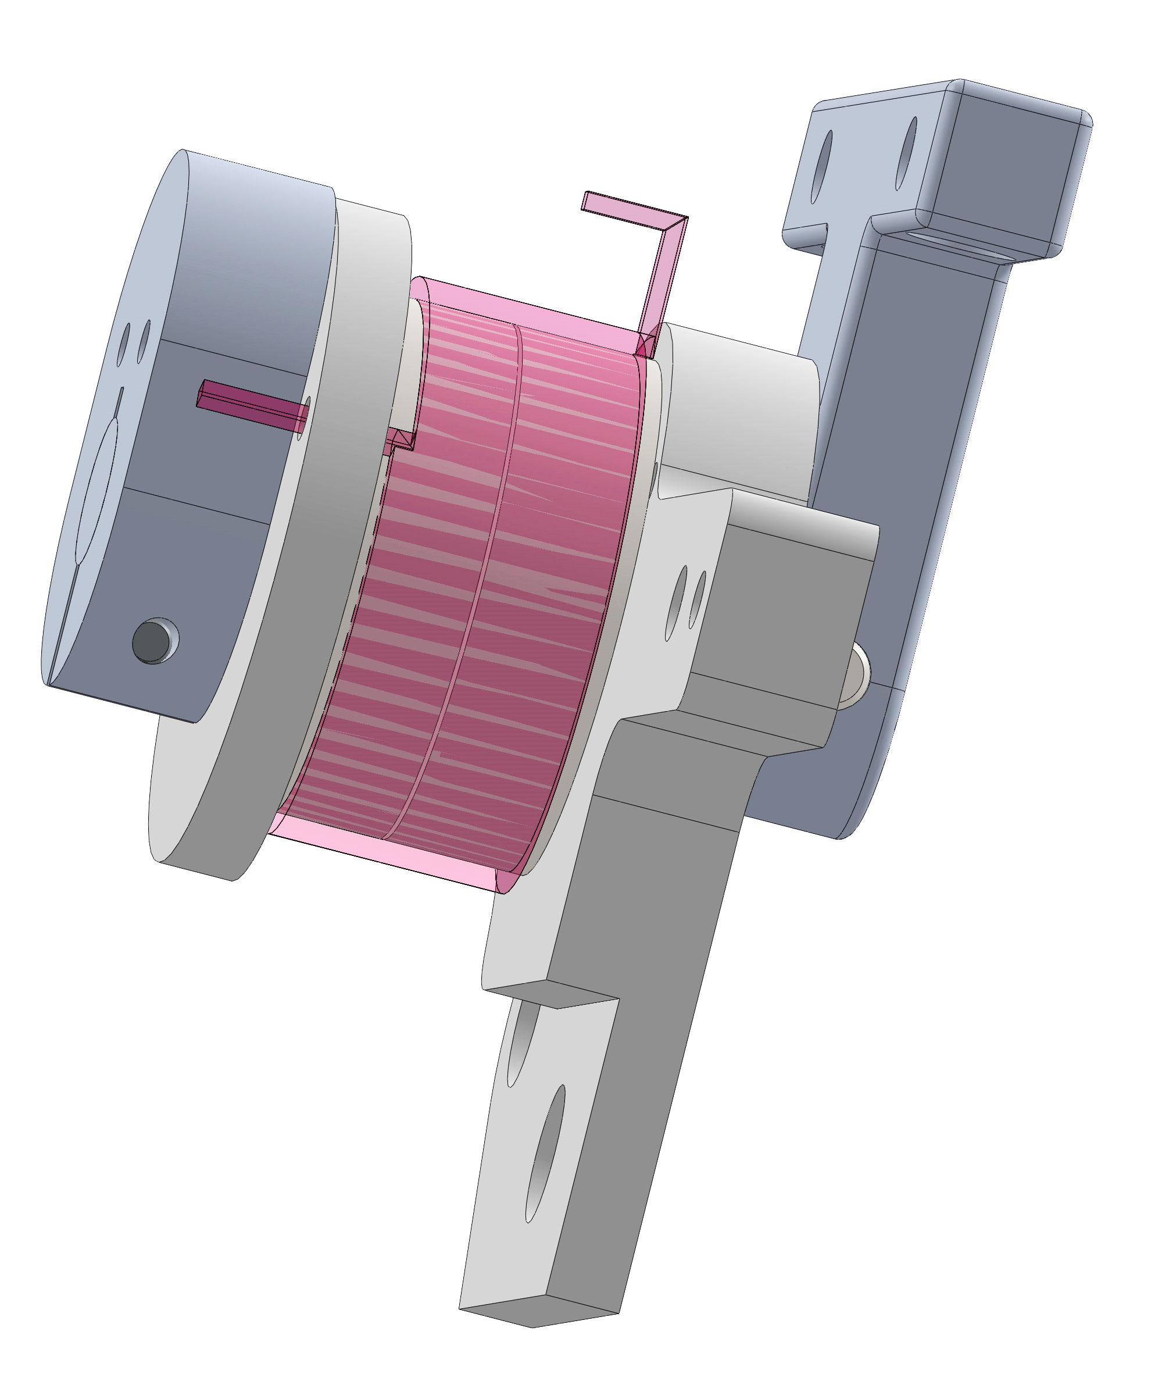
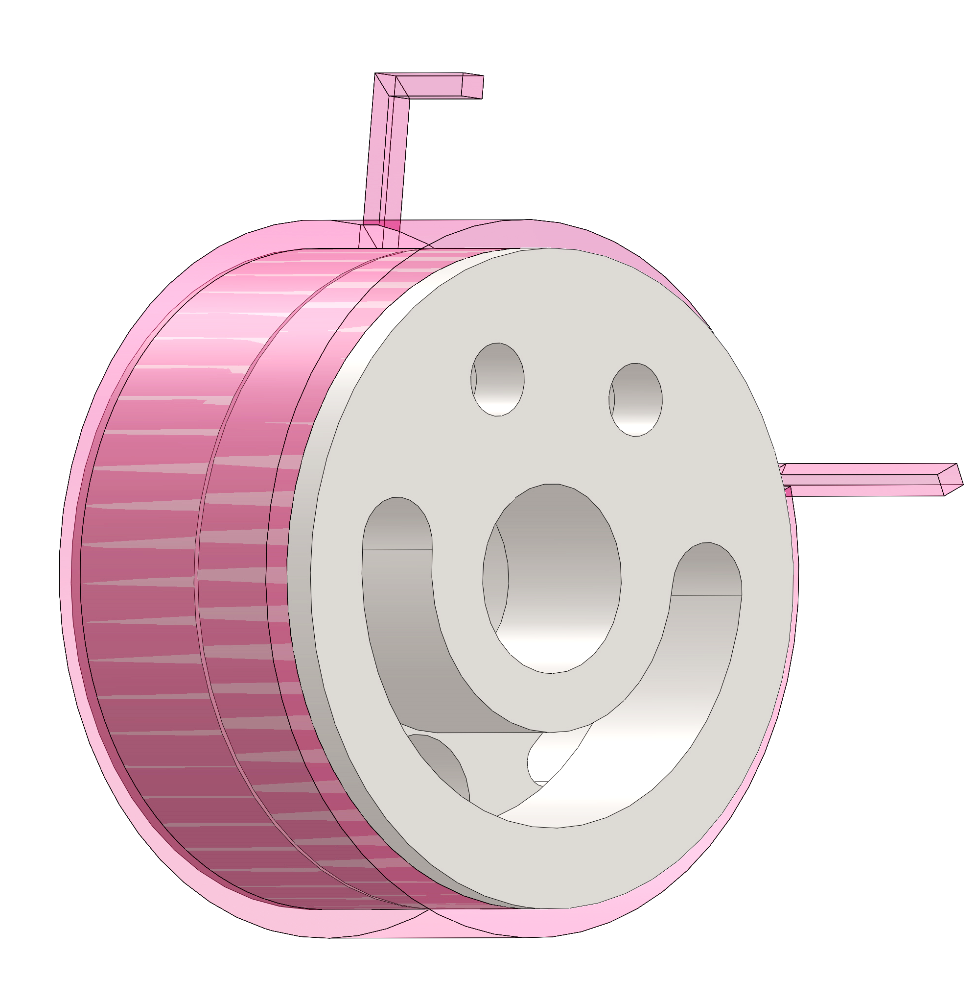
How does a wrap spring brake work?
Disc 1 (fixed)
Control tang
Disc 2 (can rotate)
Wrap spring
Notes:
Essentially works like a clutch
Braking system consists of hollow discs on a shaft and a wrap spring that is wound on the two discs
One of the discs is rigidly fixed to the shaft and the other is free to rotate in the absence of a wrap spring
In the presence of wrap spring if disc 2 roates in a direction that coils the springs on the discs, friction between the discs and the spring creates a gripping torque and stops the rotation of disc 2
If disc 2 rotates in a direction that unwinds the spring on the discs then it is free to rotate
Thus the wrap springs act as a unidirectional brake. The brake can be unlocked by a small displacement of the control tang in the direction that unwinds the spring on the discs

Slide 16
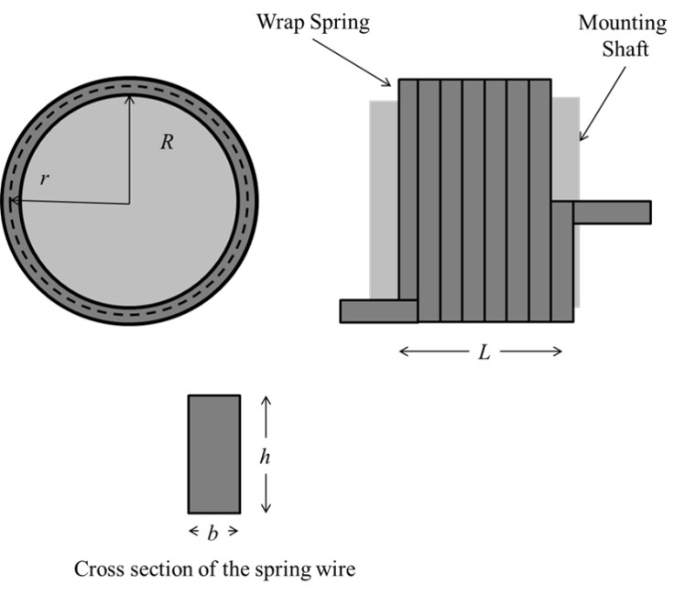

Parameters affecting the gripping torque
Gripping Torque
$T_{g}=EIR∗\frac{\left(r−r_{0}\right)}{\left(r_{0}∗r^{2}\right)}∗(e^{2πNμ} −1)$ [1]
R – Inner radius of mounted spring
r – Neutral axis of the mounted spring
r₀ – Neutral axis of the free spring
N – Number of coils in length L
μ – Coefficient of friction between spring and shaft
Notes:
The wrap springs gripping torque equation is shown here. The key parameters that affect it are number of coils, friction, and interference between spring and discs
The theoretical coefficient of friction ranges from 0.4 to 0.5 which means that theoretically the gripping torque is 3.7*10^6
But oil on the discs will lead to a drop in coeff of friction to 0.1 which reduces the Tg to 13 Nm this is because of the exponential dependence of tg on friction

Slide 17
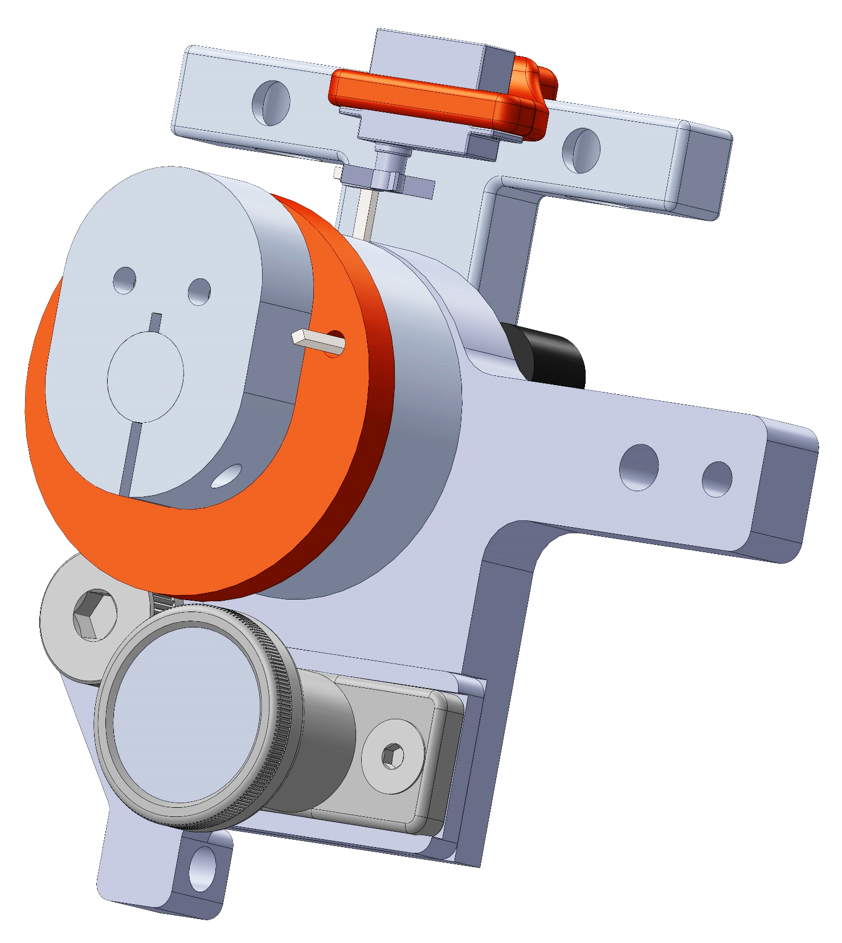
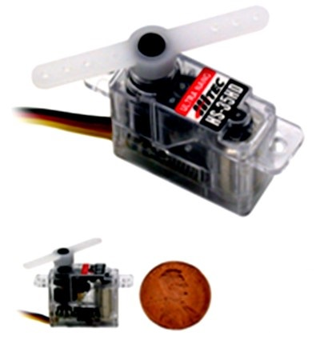
Servo motor to unlock wrap spring brake
Weighs 4.5 g
Actuation time of 0.1 sec
Moment arm to unlock brake is 6.5 mm
Servo motor
Wrap spring
Pin joint
Spring-loaded plunger
Servo motor on the knee joint
Hitec HS-35HD Ultra Nano Servo Motor
Notes:
Hitec servo motors were used to control the locking and unlocking of the brakes
These servos are light, compact and have a fast response time.
moment arm needed for required force is calculated using the simple equation Moment arm =Torque/ Force =(0.8*78.480)/9.6 = 6.536 mm
Measured the force required for disengagement using a force sensor

Slide 18
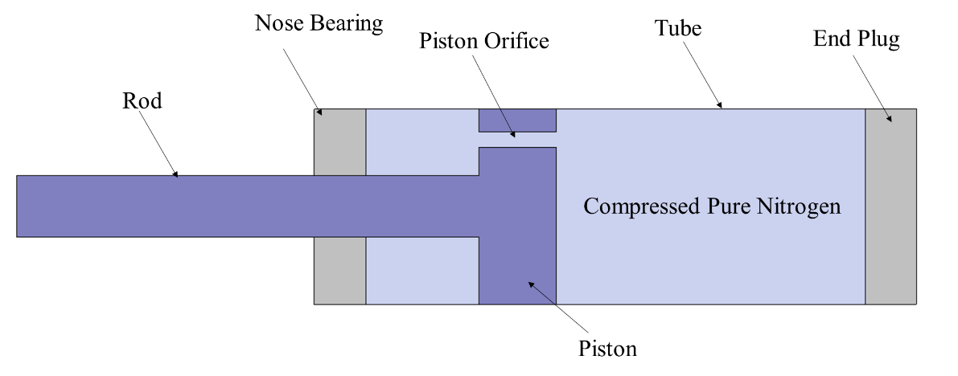
Gas springs as energy storing elements
Notes:
A gas spring is a system consisting of a pressure tube, a rod, and a piston. The energy for the spring is provided by gas at high pressure. The whole system is self-contained and sealed against loss. Gas springs expand and contract smoothly, they’re compact and last several years without any maintenance. They also exert constant force which is desirable for an exoskeleton application. For these reasons, they were picked as the energy storing elements of the ESO.

Slide 19
Conditions to be satisfied for gas spring combination to result in desired motion
The quadriceps should provide enough FES torque to compress ETS and KS during knee extension. FES torque should be kept as low as possible to reduce muscle fatigue
ETS should compress the HS during hip extension
HS should flex hip against gravity, KS should flex knee against gravity
Notes:
For the gas springs to produce the desired motion certain conditions must be met
First the quads
During hip extension, ETS compresses the HS so it must be capable of doing so
Matlab scripts were written that took these conditions into account and generated gas spring combinations that would work
During back to equilibrium phase HS should be strong enough ….

Slide 20
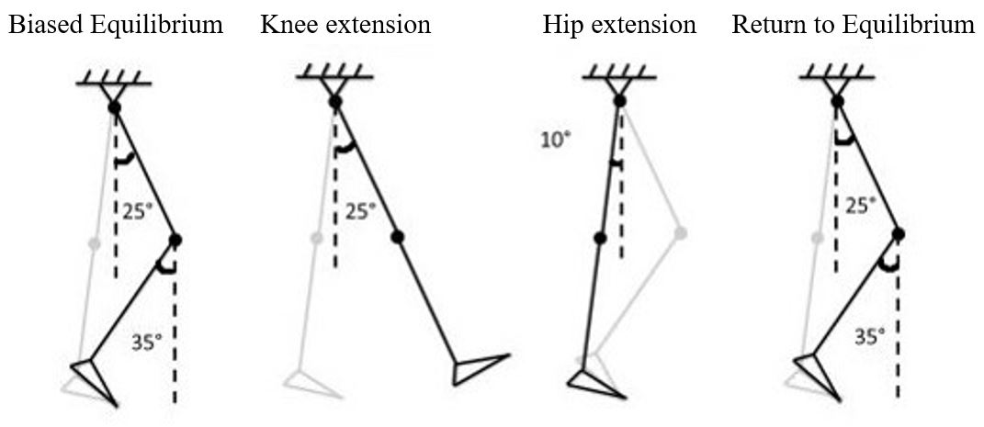
15 lbs knee spring produces required flexion
Notes:
Shown here is a matlab plot of the total knee torque during back to equilibrium phase for a ks of 15 lbs
At -53 deg the torque becomes 0 and beyond this value it reverses so the knee can flex to 53 deg

Slide 21
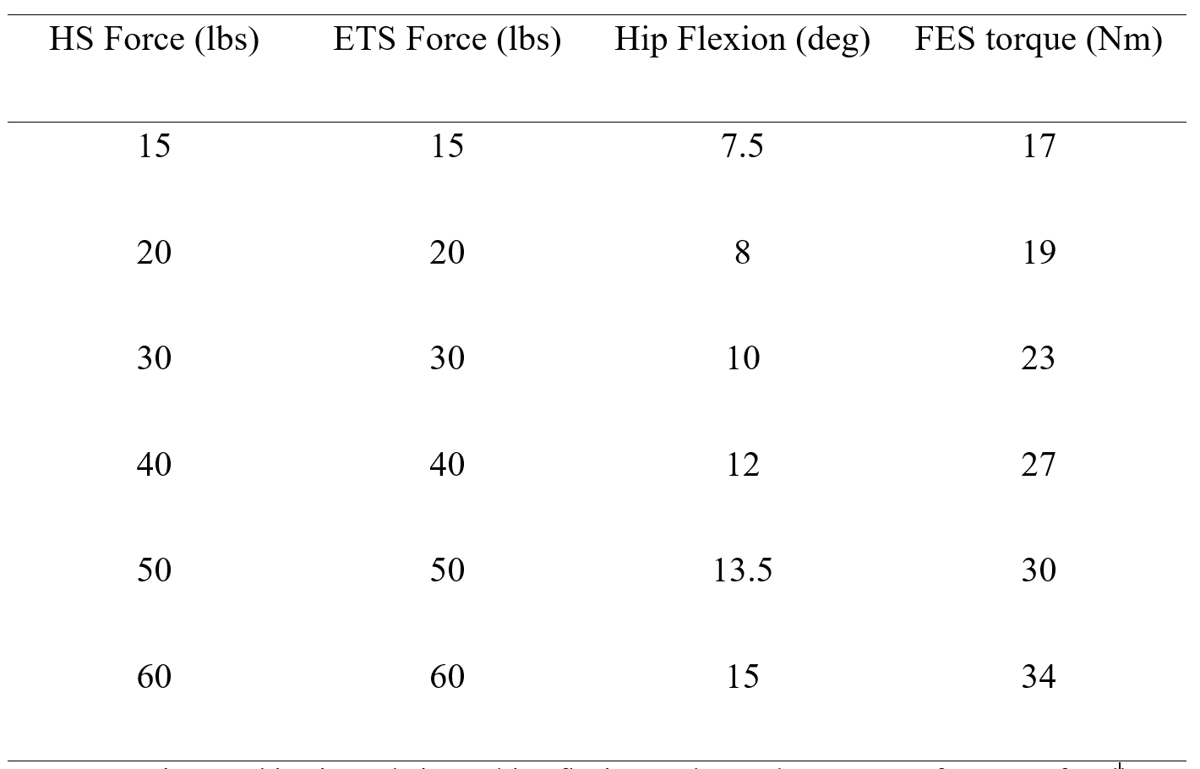
Gas spring selection
Notes:
This table shows the combination of gas springs that would work and the required FES torque for each combination
Hip flexion angle should be high enough for the foot to clear the ground during knee extension. But at the same time a highe hip flexion angle leads to a higher FES torque requirement and this fes torque must be kept low to reduce muscle fatigue.
The combination of 30 lbs ets 30 lbs hs 15 lbs ks was picked as the hip flexion for this combination was just enough to clear the ground as determined by preliminary tests on a non-impaired individual

Slide 22
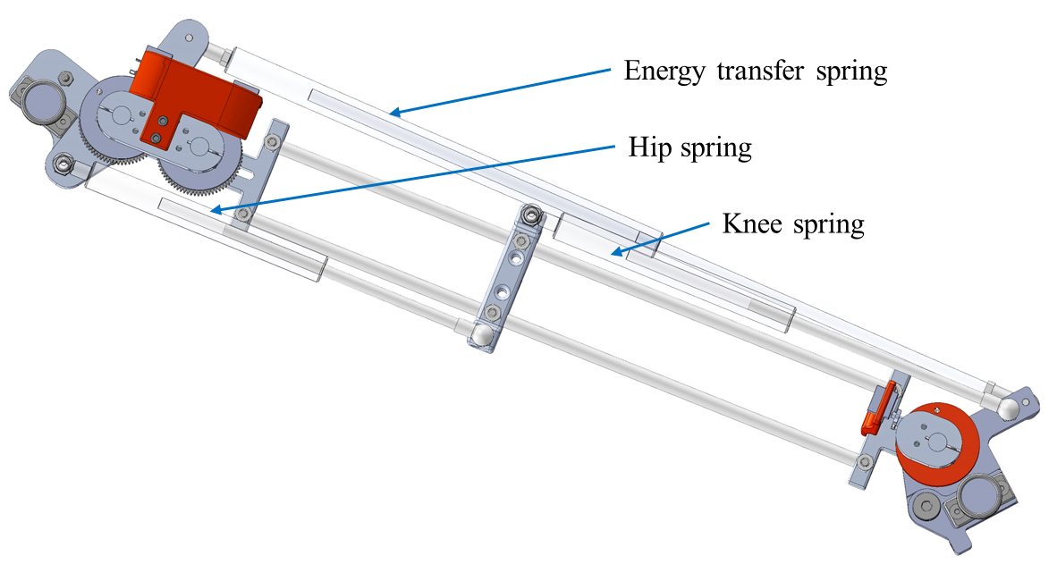
Thigh component
Notes:
Moving on to the design of the structure, shown here is a rendering of the thigh component of the FES-ESO
It consists of the hip joint, the knee joint and the three gas springs
The idea was to have all the complexity on this component

Slide 23
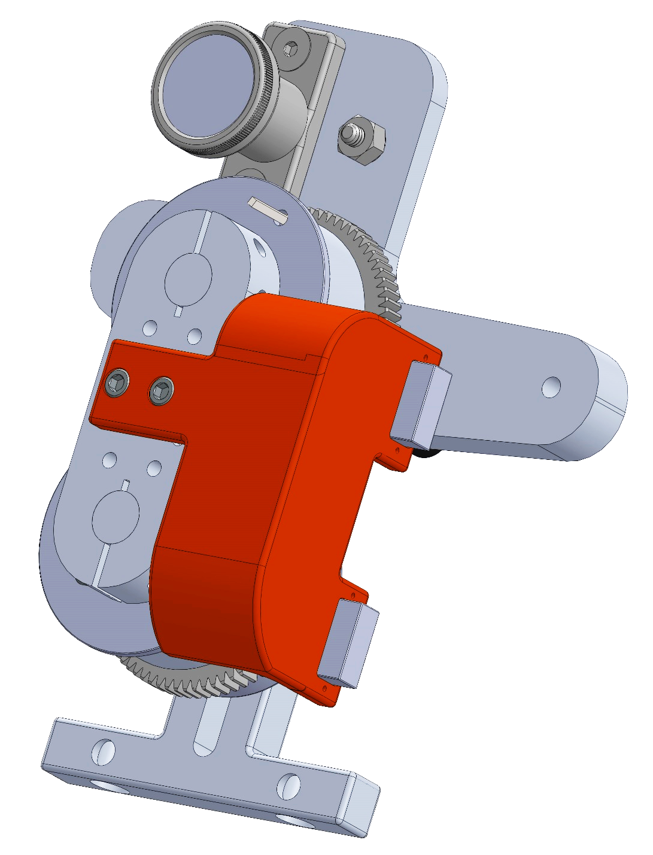
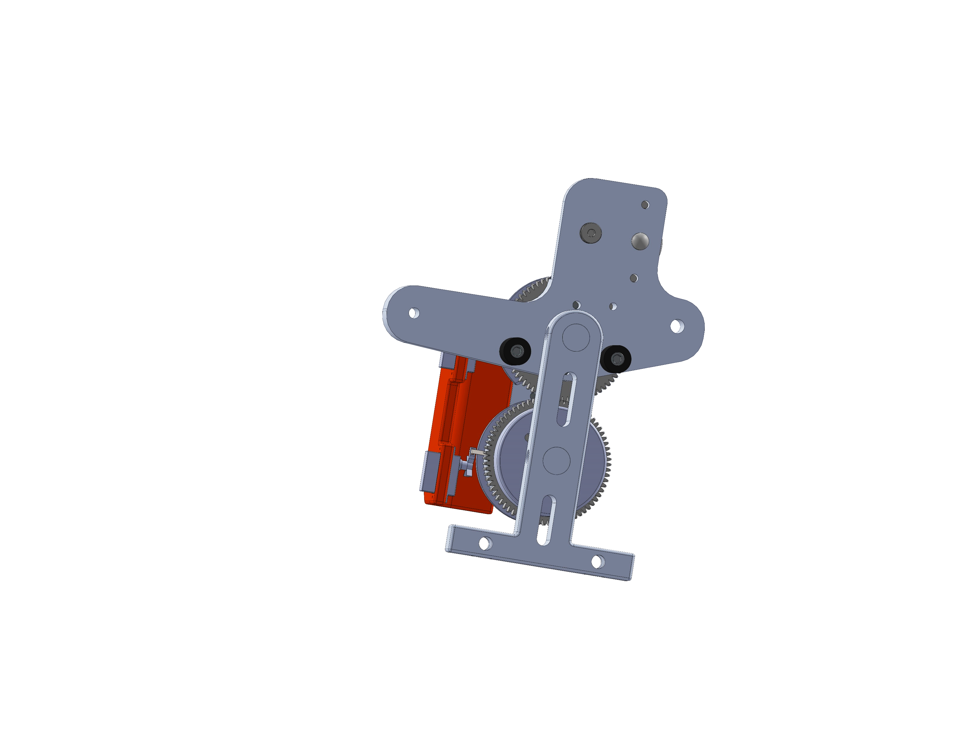
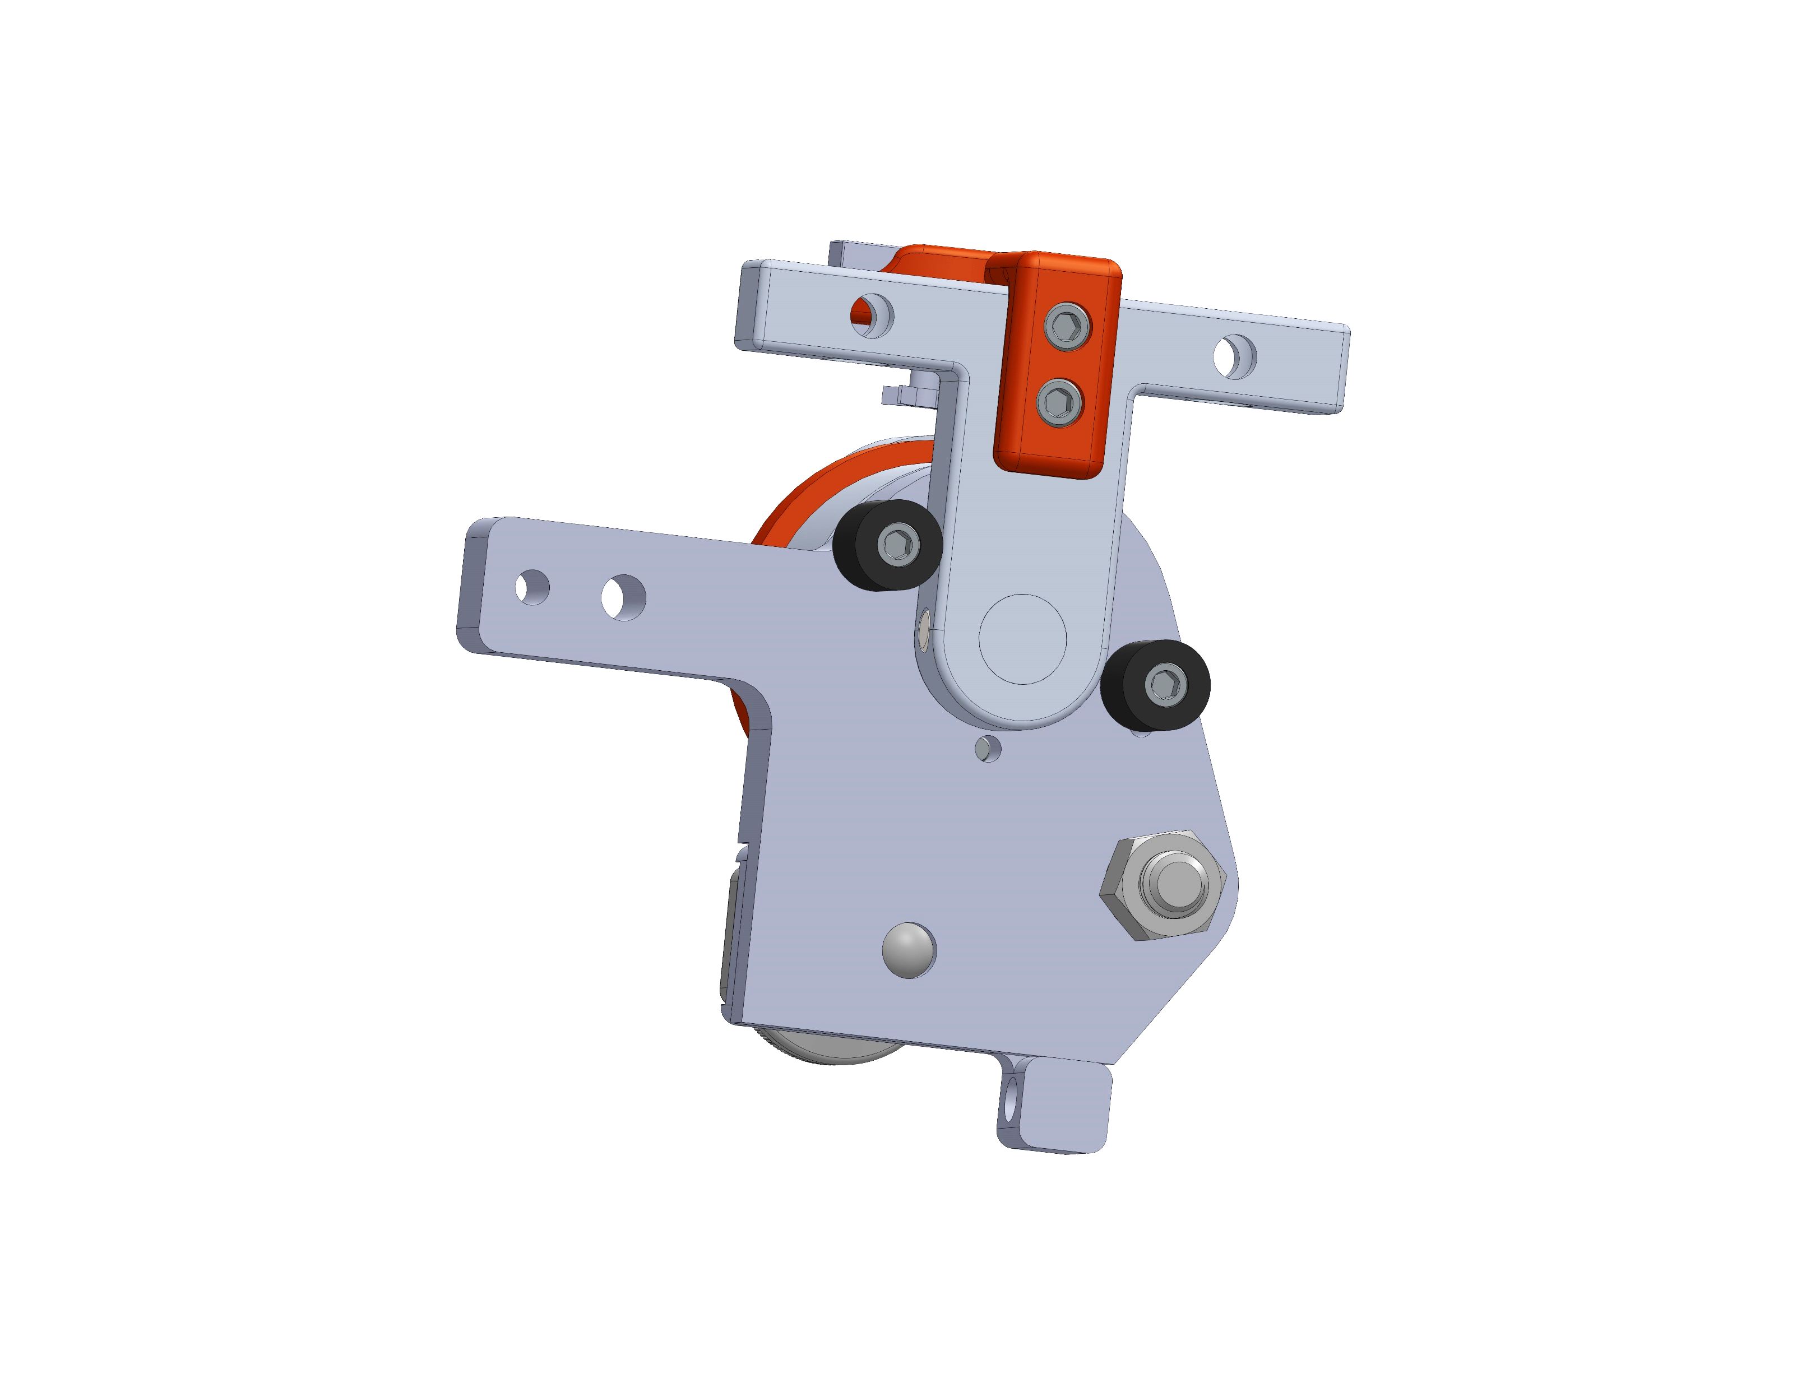
Hip and knee joint
Spring-loaded plunger
Servo motor
Pin joint
Wrap spring
Wrap spring 1
Gear
Pin joint
Servo motors
Spring-loaded plunger
Wrap spring 2
Rubber bumpers
Notes:
Shown here on the left is a rendering of the hip joint. It consists of two wrap springs that are coupled by gears for a bi-directional brake.
Servo motors are used to transition between locked and unlocked states of the wrap spring brake
An additional pin joint allows sitting to standing range of motion independent from spring forces, this pin joint can be locked or unlocked using a spring loaded plunger
Shown on the right is a rendering of the knee joint. Its design is similar to the hip joint.
However, it uses a single wrap spring as the knee joint only needs to be locked in flexion
It also uses servo motors to lock/ unlock the brake
An additional pin joint allows sit-stand rom and can be locked or unlocked with a spring plunger
Rubber bumpers act as rotational hard stops and are used to constraint the joint rotations to specific angles
They also act as additional safety measures to prevent collapse of the users in cae the wrap sorng brakes fail.

Slide 24
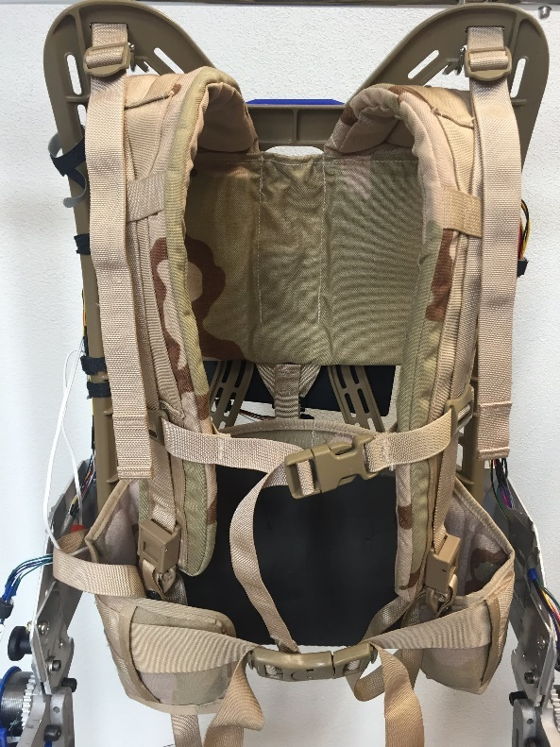
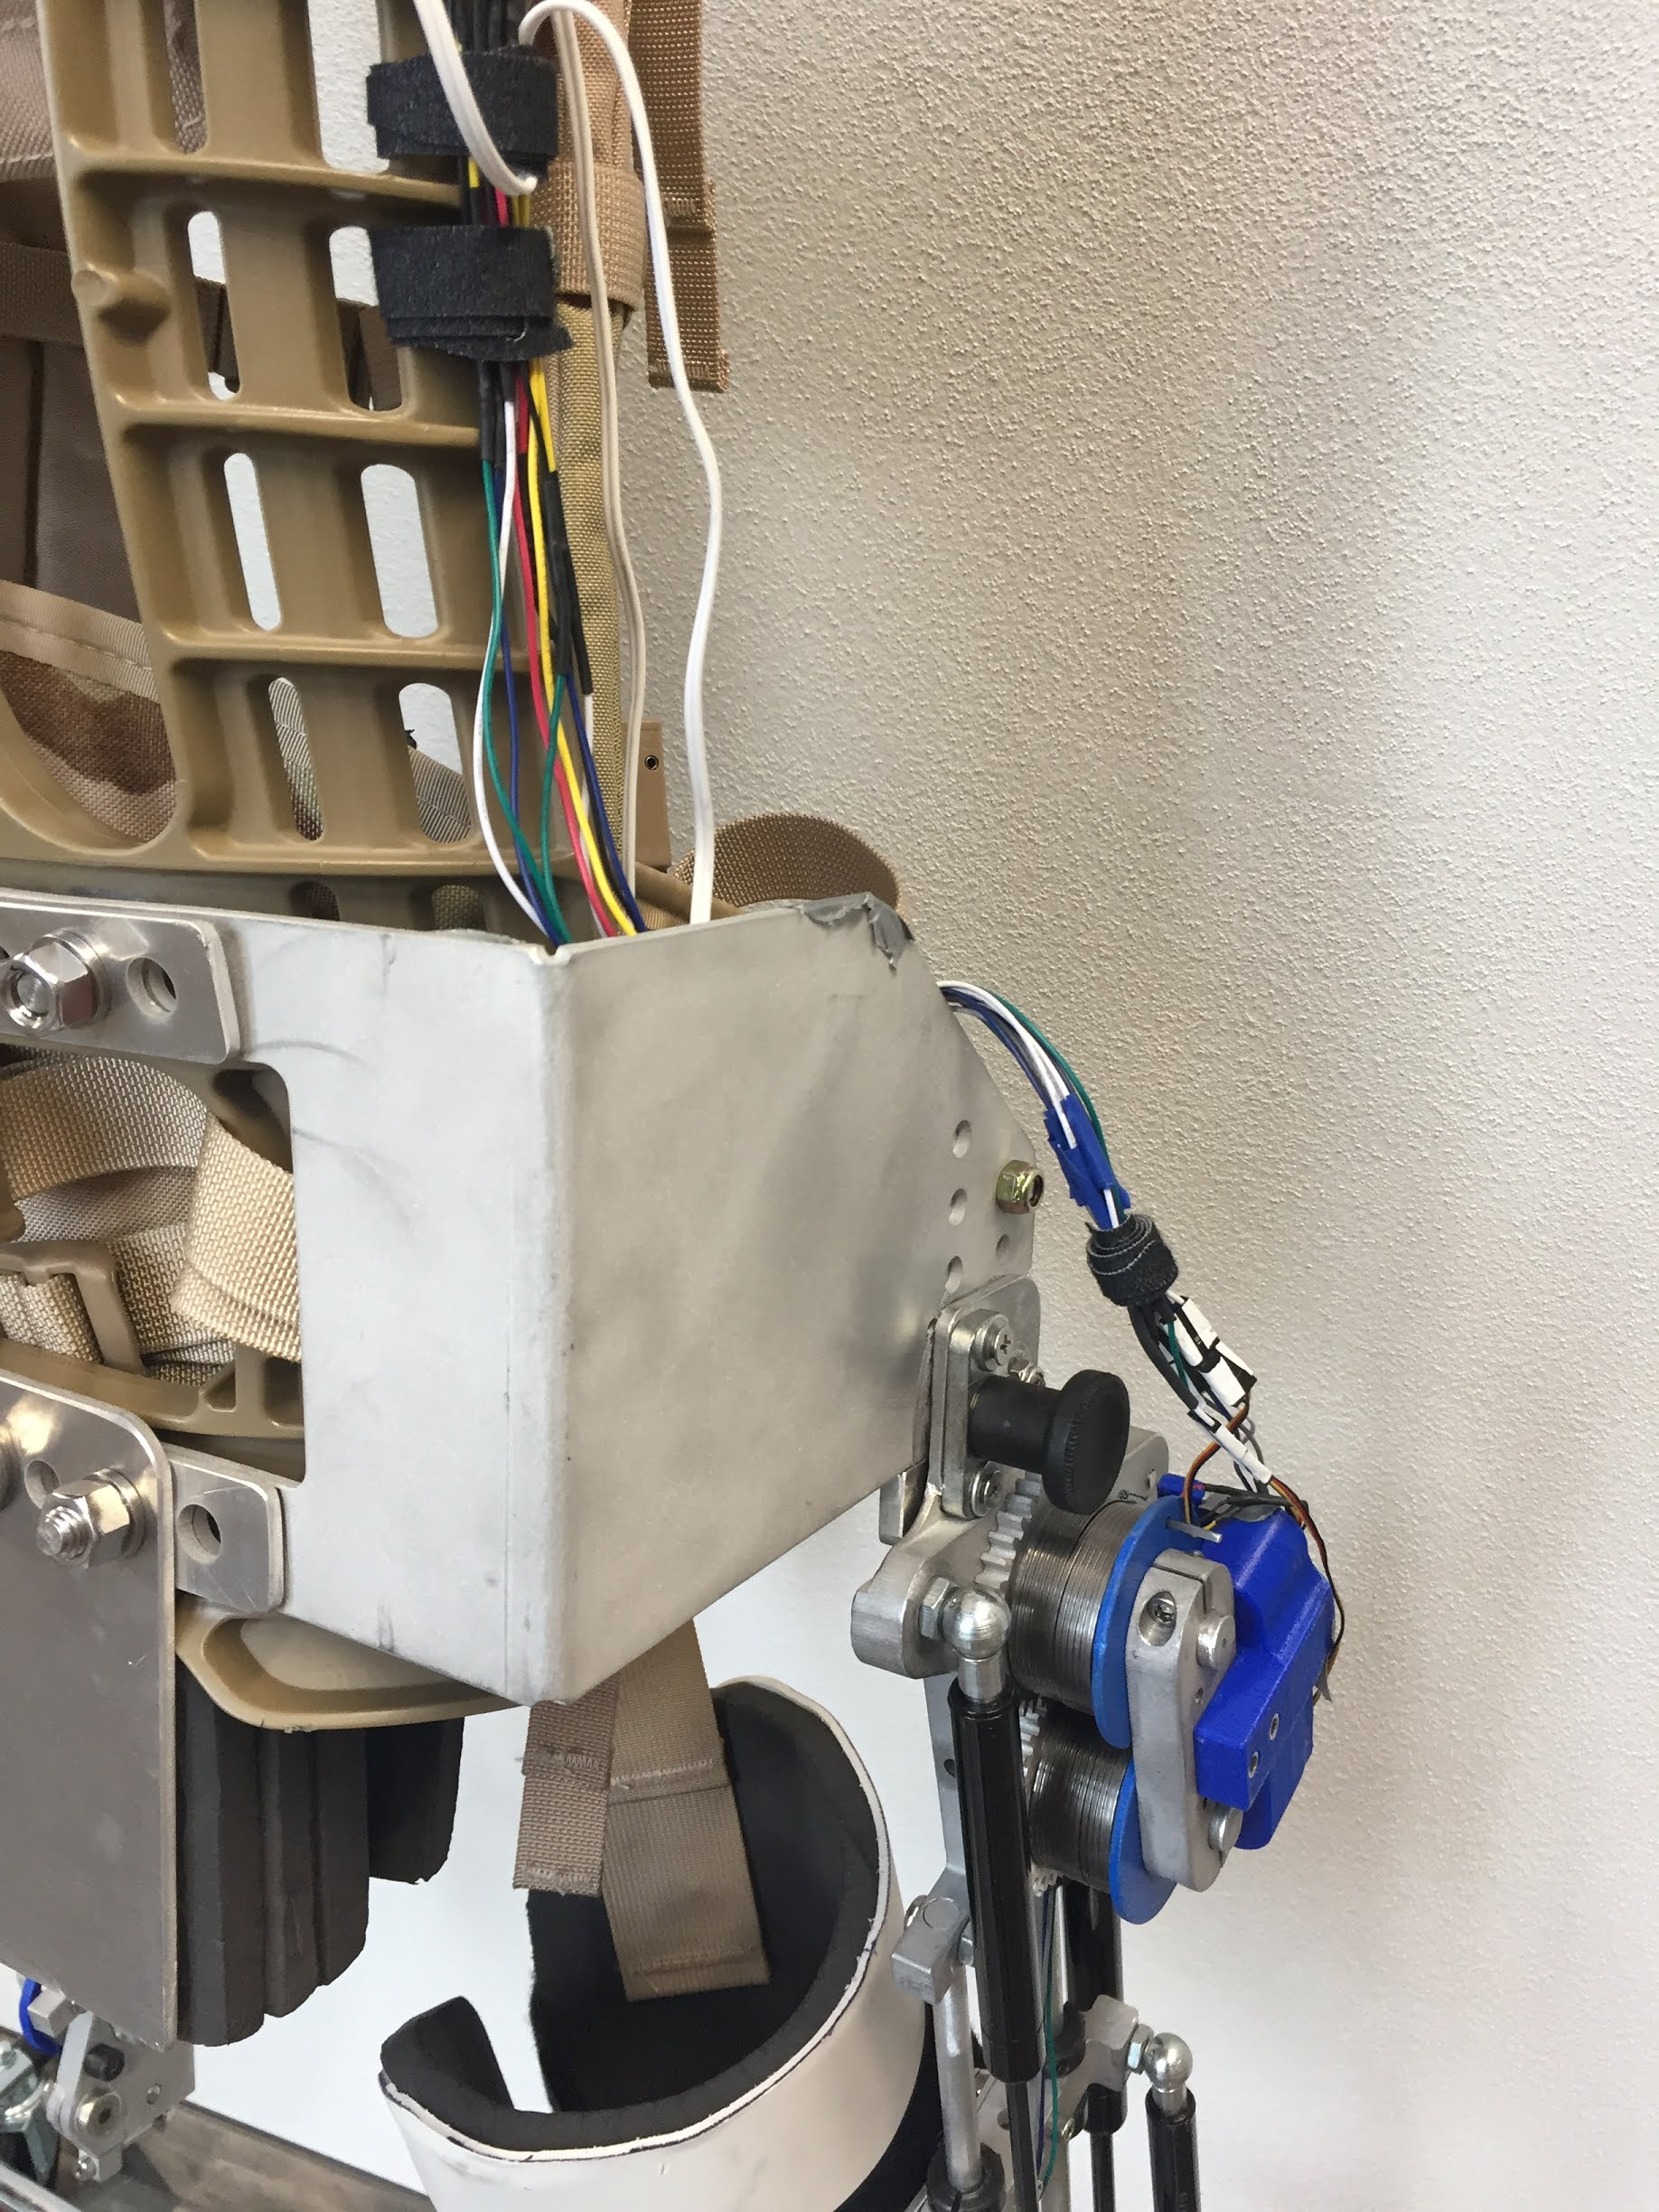
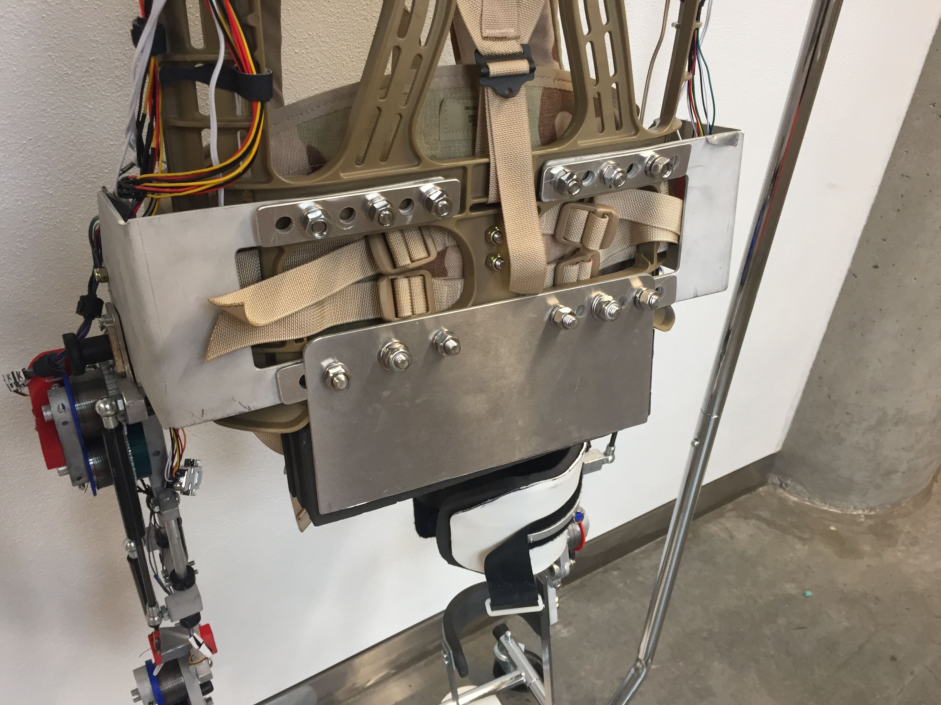
Torso attachment
Molle military backpack
Aluminum attachment for added support at the glutes
Aluminum Torso Attachment Plate
Notes:
A MOLLE military backpack was used to attach the FES-ESO to the users torso
An aluminum attachment was added to extend the backpack down towards the glutes for added support and to prevent relative movement at the hip

Slide 25
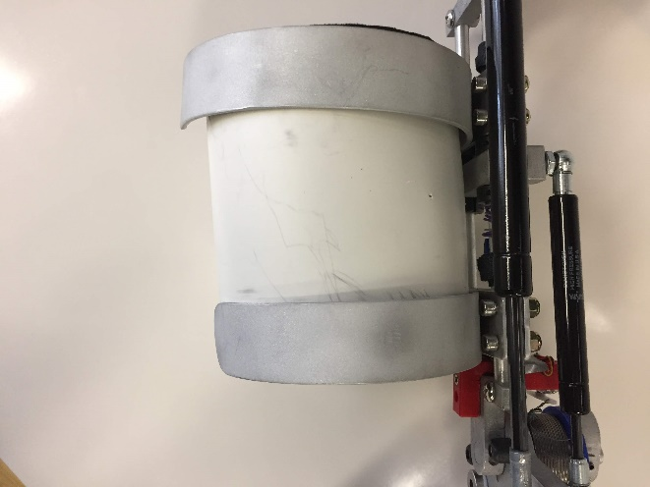
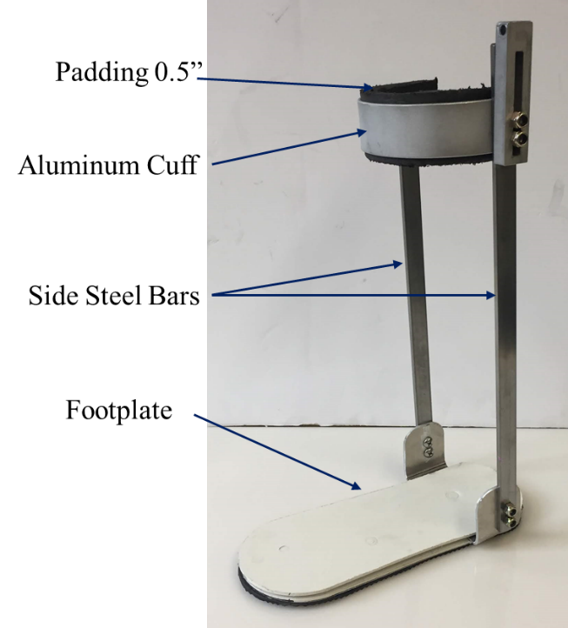
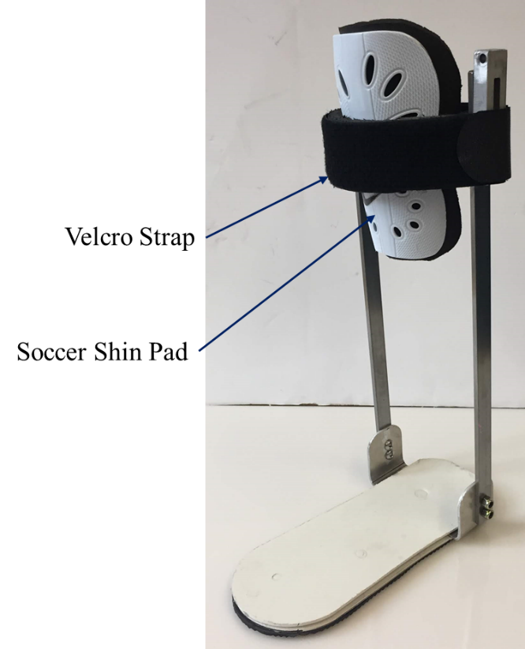
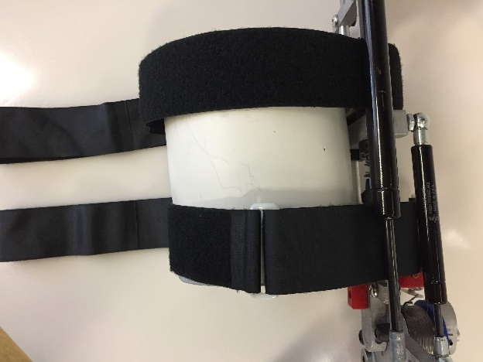
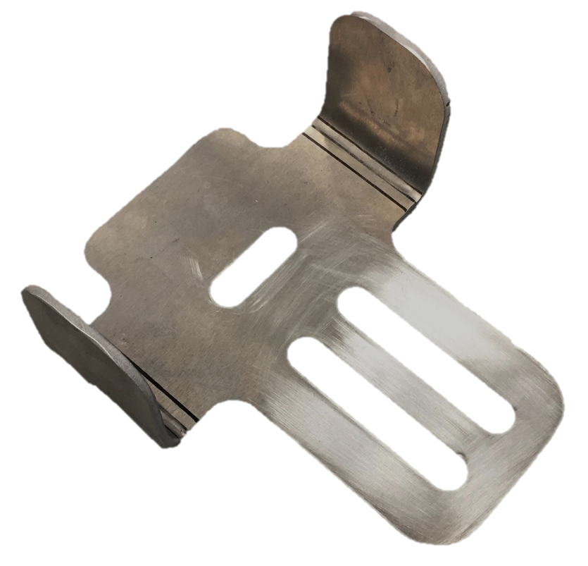
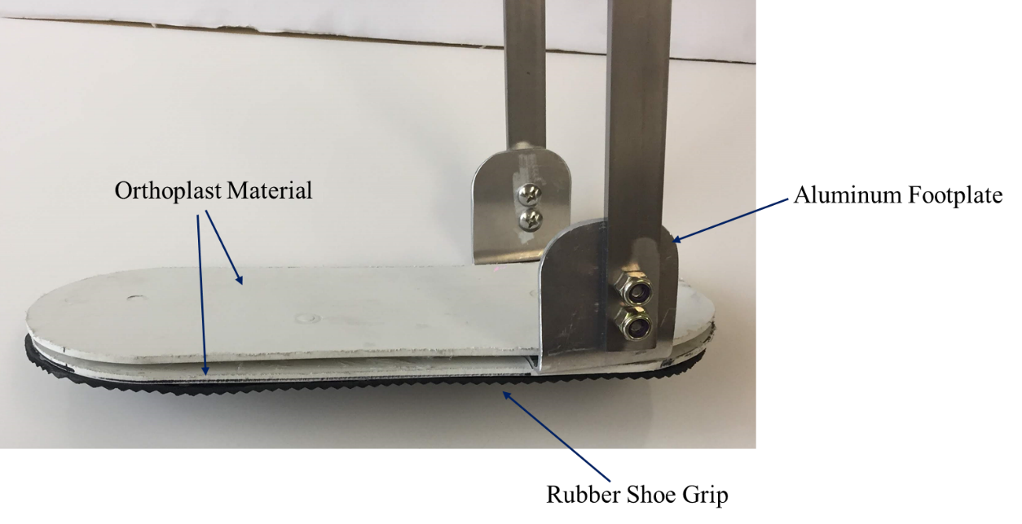
Thigh attachment
Shank attachment
Orthoplast
Velcro
Velcro
Notes:
The thigh attachment shown on the left consist of two rigid aluminum cuffs that attach to the structure of the FES-ESO
Underneath this is a layer of orthoplast (low temp thermoplastic used for splinting). The inside of orthoplast is lined with 0.5” padding to prevent chafing.
Orthoplast and padding together form a thigh pad which is secured to the aluminum cuff using velcro
The shank attachment is shown on the right. It consists of a padded rigid aluminum cuff connected to two side steel bars which run down the lower leg and connect to the passive ankle. A soccer shin pad is placed on the users shin and a Velcro is used to secure the shank attachment to the users leg.
Th passive ankle consists of an aluminum foot plate which is sandwiched between orthoplast materials. The base of the foot plate is covered with rubber shoe grip material. The purpose of the footplate is to prevent foot drop while walking.

Slide 26
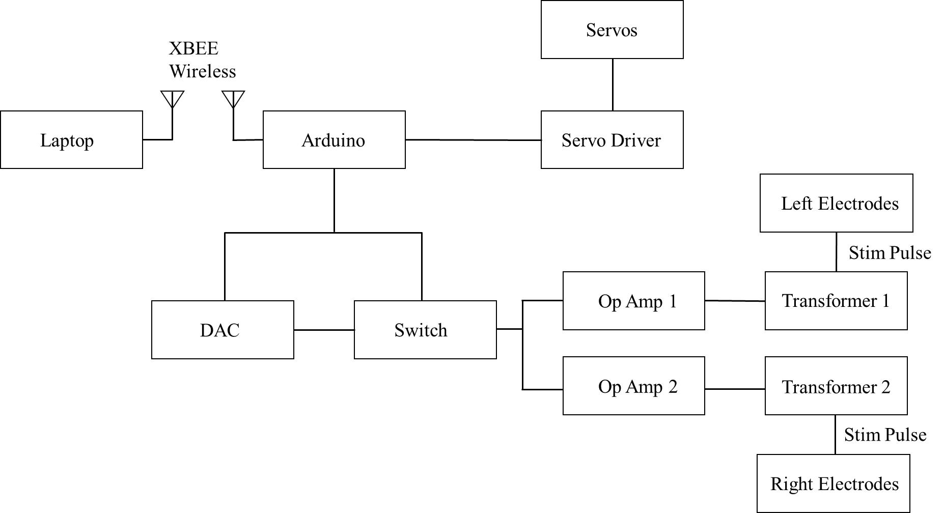
Electronics architecture
Notes:
The electronics for the ESO need to actuate the servos that control the locking and unlocking of the joints, create and control the stimulation pulses to contract the quadriceps.
The theoretical stimulation pulse needed to contract the quads is shown in the right corner
Xbee wireless is used to communicate with the Arduino. The servos are driven by an adafruit servo driver which receives inputs from an Arduino metro mini.
To create stimulation pulses the Arduino sends a digital value to a DAC.
The output of the DAC is connected to a switch (MAX323) which allows the creation of a pulse with a specific width and frequency
The parameter of interest is the current passing through the electrodes placed on the quadriceps and not the voltage. To convert the constant voltage pulse into a constant current pulse, the output of the switch is sent to an operational amplifier
The transformer then converts low voltage, high current signal to a high voltage low current signal which is then sent to the electrodes placed on the quadriceps
A single stimulation pulse recorded on an oscilloscope is shown on the bottom right

Slide 27
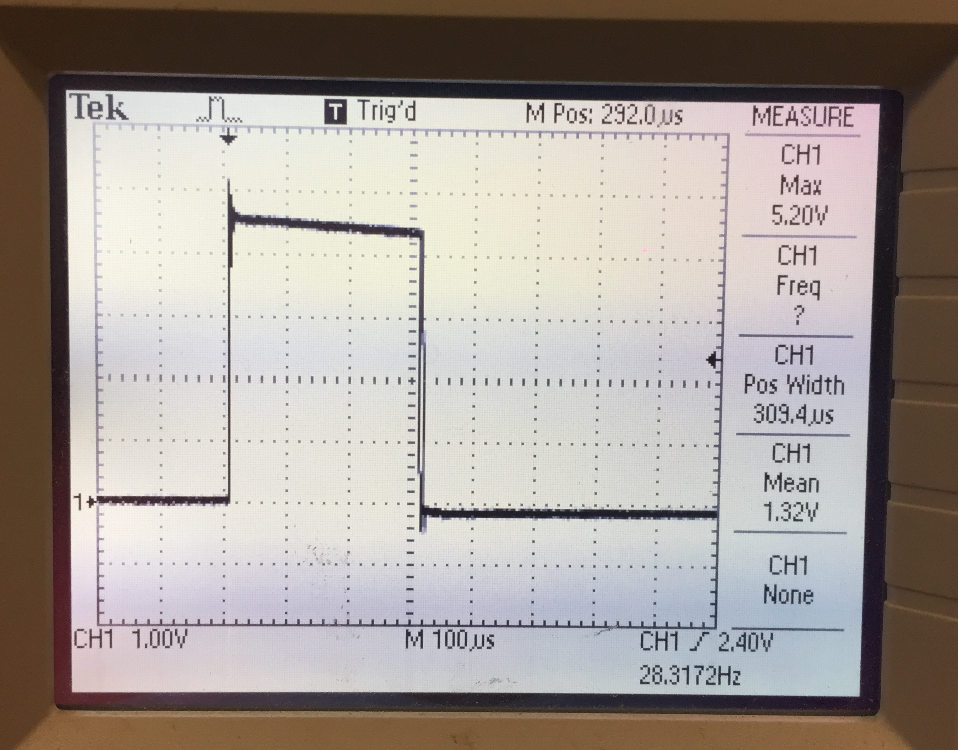
Stimulation pulse
PA
PW
Pulse Amplitude (PA)
Pulse Width (PW)
Pulse Frequency (PF)

Slide 28
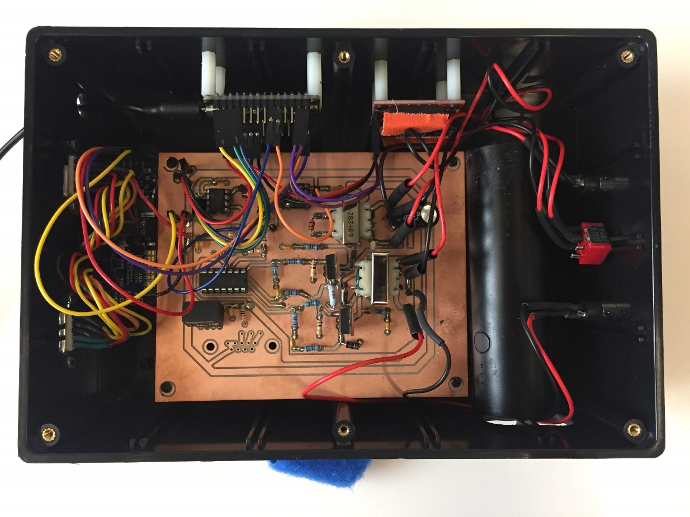
Electronics enclosure

Slide 29
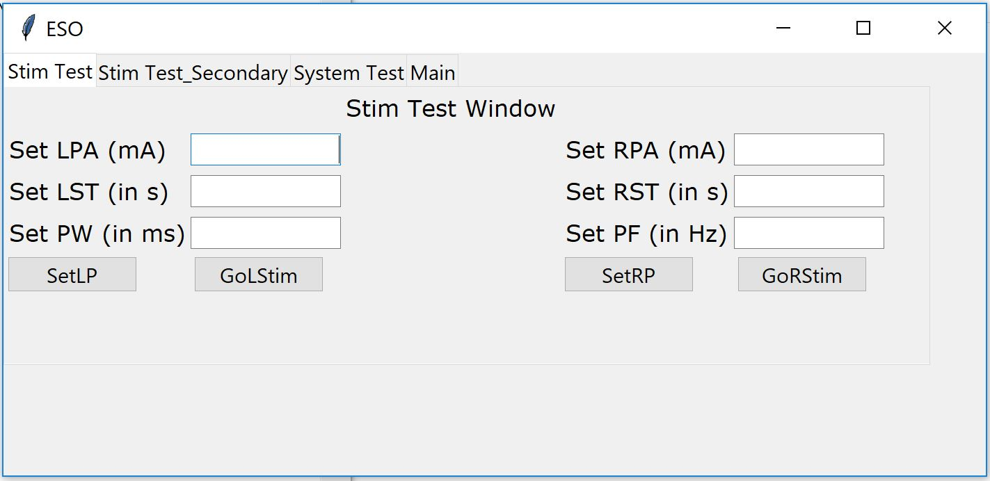
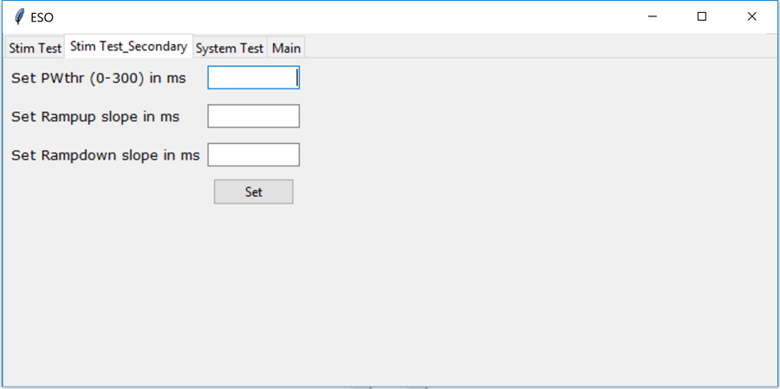
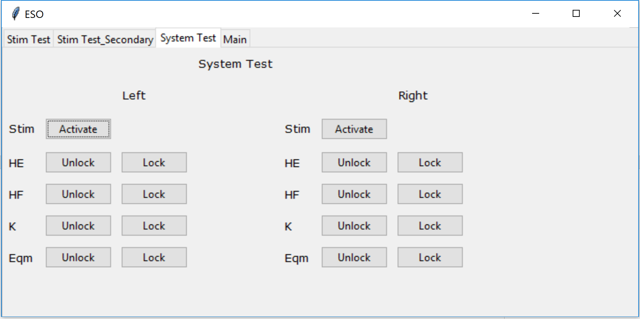
GUI
Notes:
10 sec on this slide state that it was done in python that’s it
Shown here are three tabs on the GUI which was created using Tkinter module in python
The first tab is a stimulation test window and is used to modify the parameters of stimulation to learn the right set to produce the required FES torque.
The second tab has additional stimulation parameters that are used less frequently such as ramp up, ramp down slopes, and pulse width threshold.
In the system test tab, individual servos can be actuated or stopped with a press of a button and the stimulation can be activated using a different button. The stim button on this tab uses the default parameters or the ones that were set in the first tab.

Slide 30
Evaluation tests
Wrap spring torque test
Bench top gait cycle test
Non-impaired user test
Preliminary user test

Slide 31
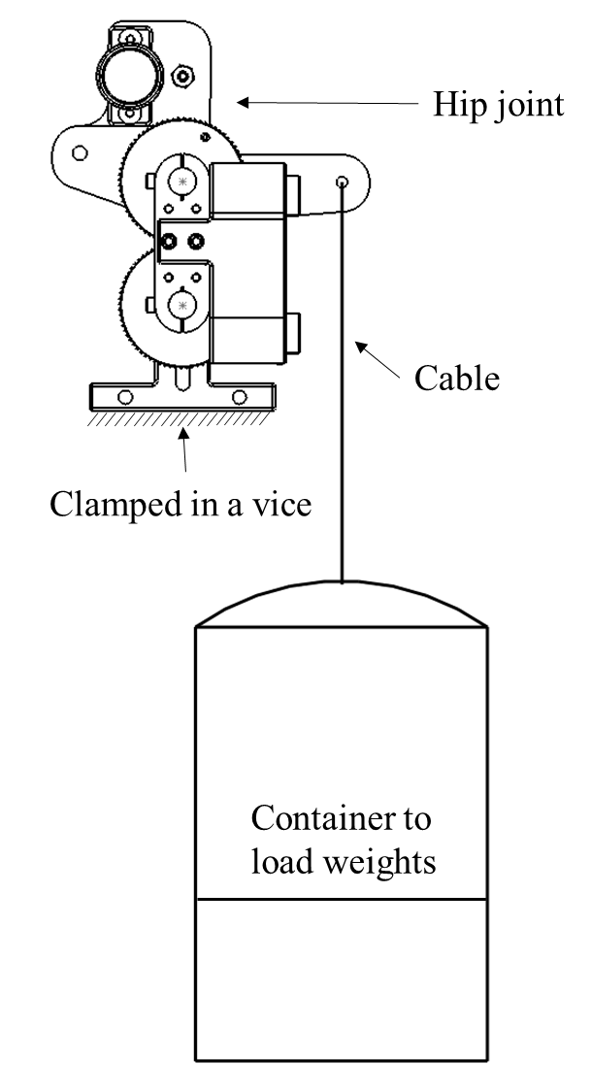
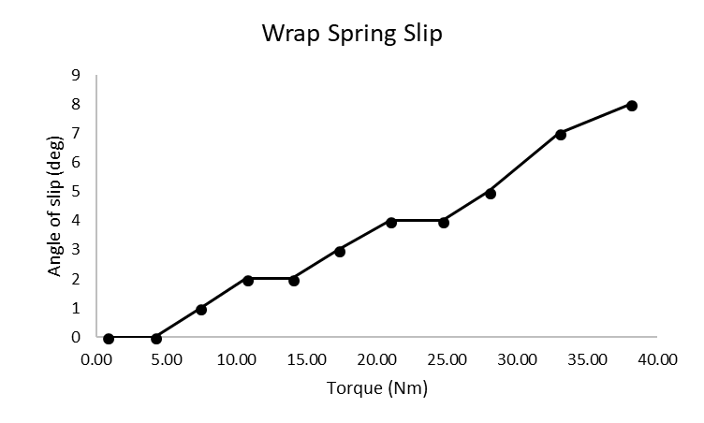
Wrap spring torque tests
Design requirement 31Nm
Knee joint could hold atleast 33.2 Nm
Hip joint could hold atleast 36.2 Nm
Notes:
Moving on to evalution of the FES-ESO
Wrap spring torque tests were conducted by clamping the joints in a bench top vice hanging weight soff a moment arm.
The weight were added incrementally and the angle at the joint was measured using a goniometer after adding each additional weight. It was seen that after adding each additional weight the brake slipped by a few degrees.
The plot shows the slip of the wrap spring brake. The total slip was 8 deg
The knee joint could hold at least 33 Nm and the hip joint could hold atleast 36.2 Nm

Slide 32
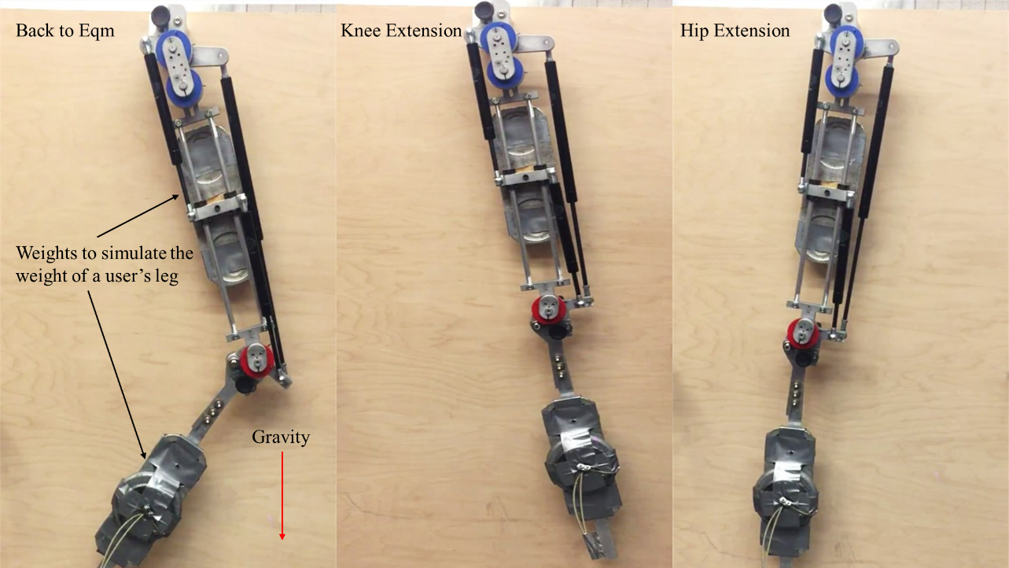
Bench top gait cycle simulation
Notes:
Bench top tests were conducted to ensure that the FES-ESO could achieve the three states during gait
The prototype was hung on a wooden board. Weights were attached to the thigh and shank segments to simulate the weight of the user’s leg. The knee was extended manually to go from equilibrium state to knee extended state. Then, the control tangs of the wrap springs were manually actuated to unlock the joints and transition from one state to another. The angles of the joints were measured using a goniometer.
The prototype was able to achieve the states and the angles matched the theoretically expected angles

Slide 33
Prototype weight
Ekso 23 kgs
ReWalk 23.3 kgs
Indego 11.8 kgs
Notes:
The device weighed 17.1 kgs which included the structure, body attachment parts, and the backpack

Slide 34
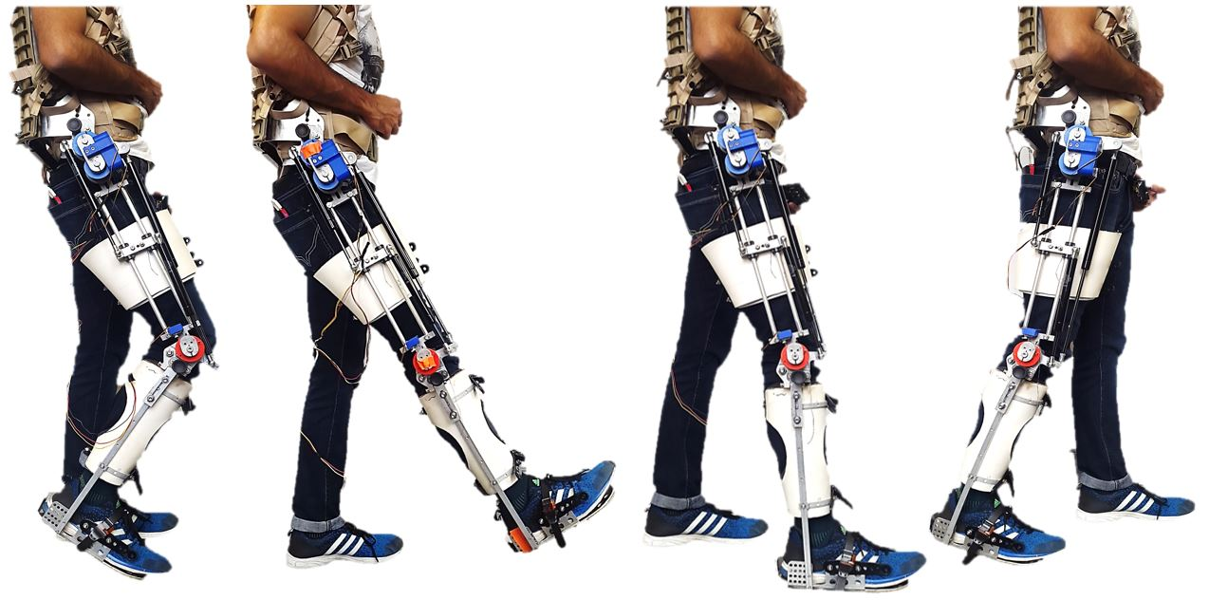
Testing on a non-impaired person
Notes:
Preliminary tests were conducted on a non-impaired individual using a one-sided early prototype to evaluate the fit and to go through a stepping sequence
Video of the person walking was analyzed using the software package MAXTRAQ to determine the knee and hip range of motion and the time for each phase of gait

Slide 35
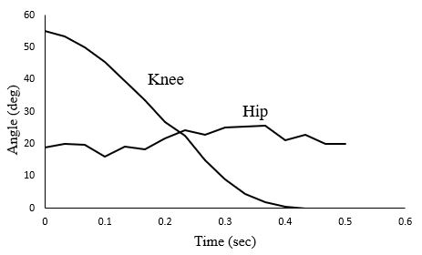
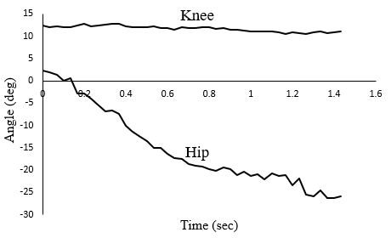
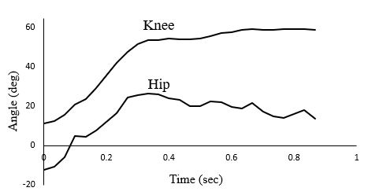
Knee extension
Testing on non-impaired person indicated that concept may be feasible
Hip extension
Back to equilibrium
Phase time = 0.5 sec
Knee angle 55 deg to 0 deg
Hip angle 20 deg
Phase time = 1.43 sec
Knee angle 11 deg
Hip angle 2 deg to -26 deg
Phase time = 0.87 sec
Knee angle 11.5 deg to 59 deg
Hip angle -12.5 deg to 14 deg
Notes:
The plot on the left shows the Knee and hip angles for the knee extension phase of gait. This phase took 0.5 sec, knee angle changed from 55 deg to 0 deg, and hip angle remained constant around 20 deg
The plot in the middle shows the angles for the hip extension phase of gait cycle. This phase took 1.43 sec, knee angle remained constant around 11 deg, and hip angle changed from 2.3 deg to -26 deg. Hard stops should prevent hip angle from going below -10 deg, but during hip extension phase an angle of -26 deg was measured which was due to the relative movement between the orthosis and the body.
The plot on the right shows the Knee and hip angles for the return to equilibrium phase of gait cycle. This phase took 0.87 sec, knee angle changed from 11.5 deg to 59 deg, and hip angle changed from -12.5 deg to 13.8 deg

Slide 36
The summed time for the three phases of gait was 2.8 sec
Estimated walking speed was 0.27 m/s
Notes:
The summed time for the three phases of gait was 2.8 sec
The distance covered during one right step was 0.76 m and the estimated walking speed was 0.27 m/s

Slide 37
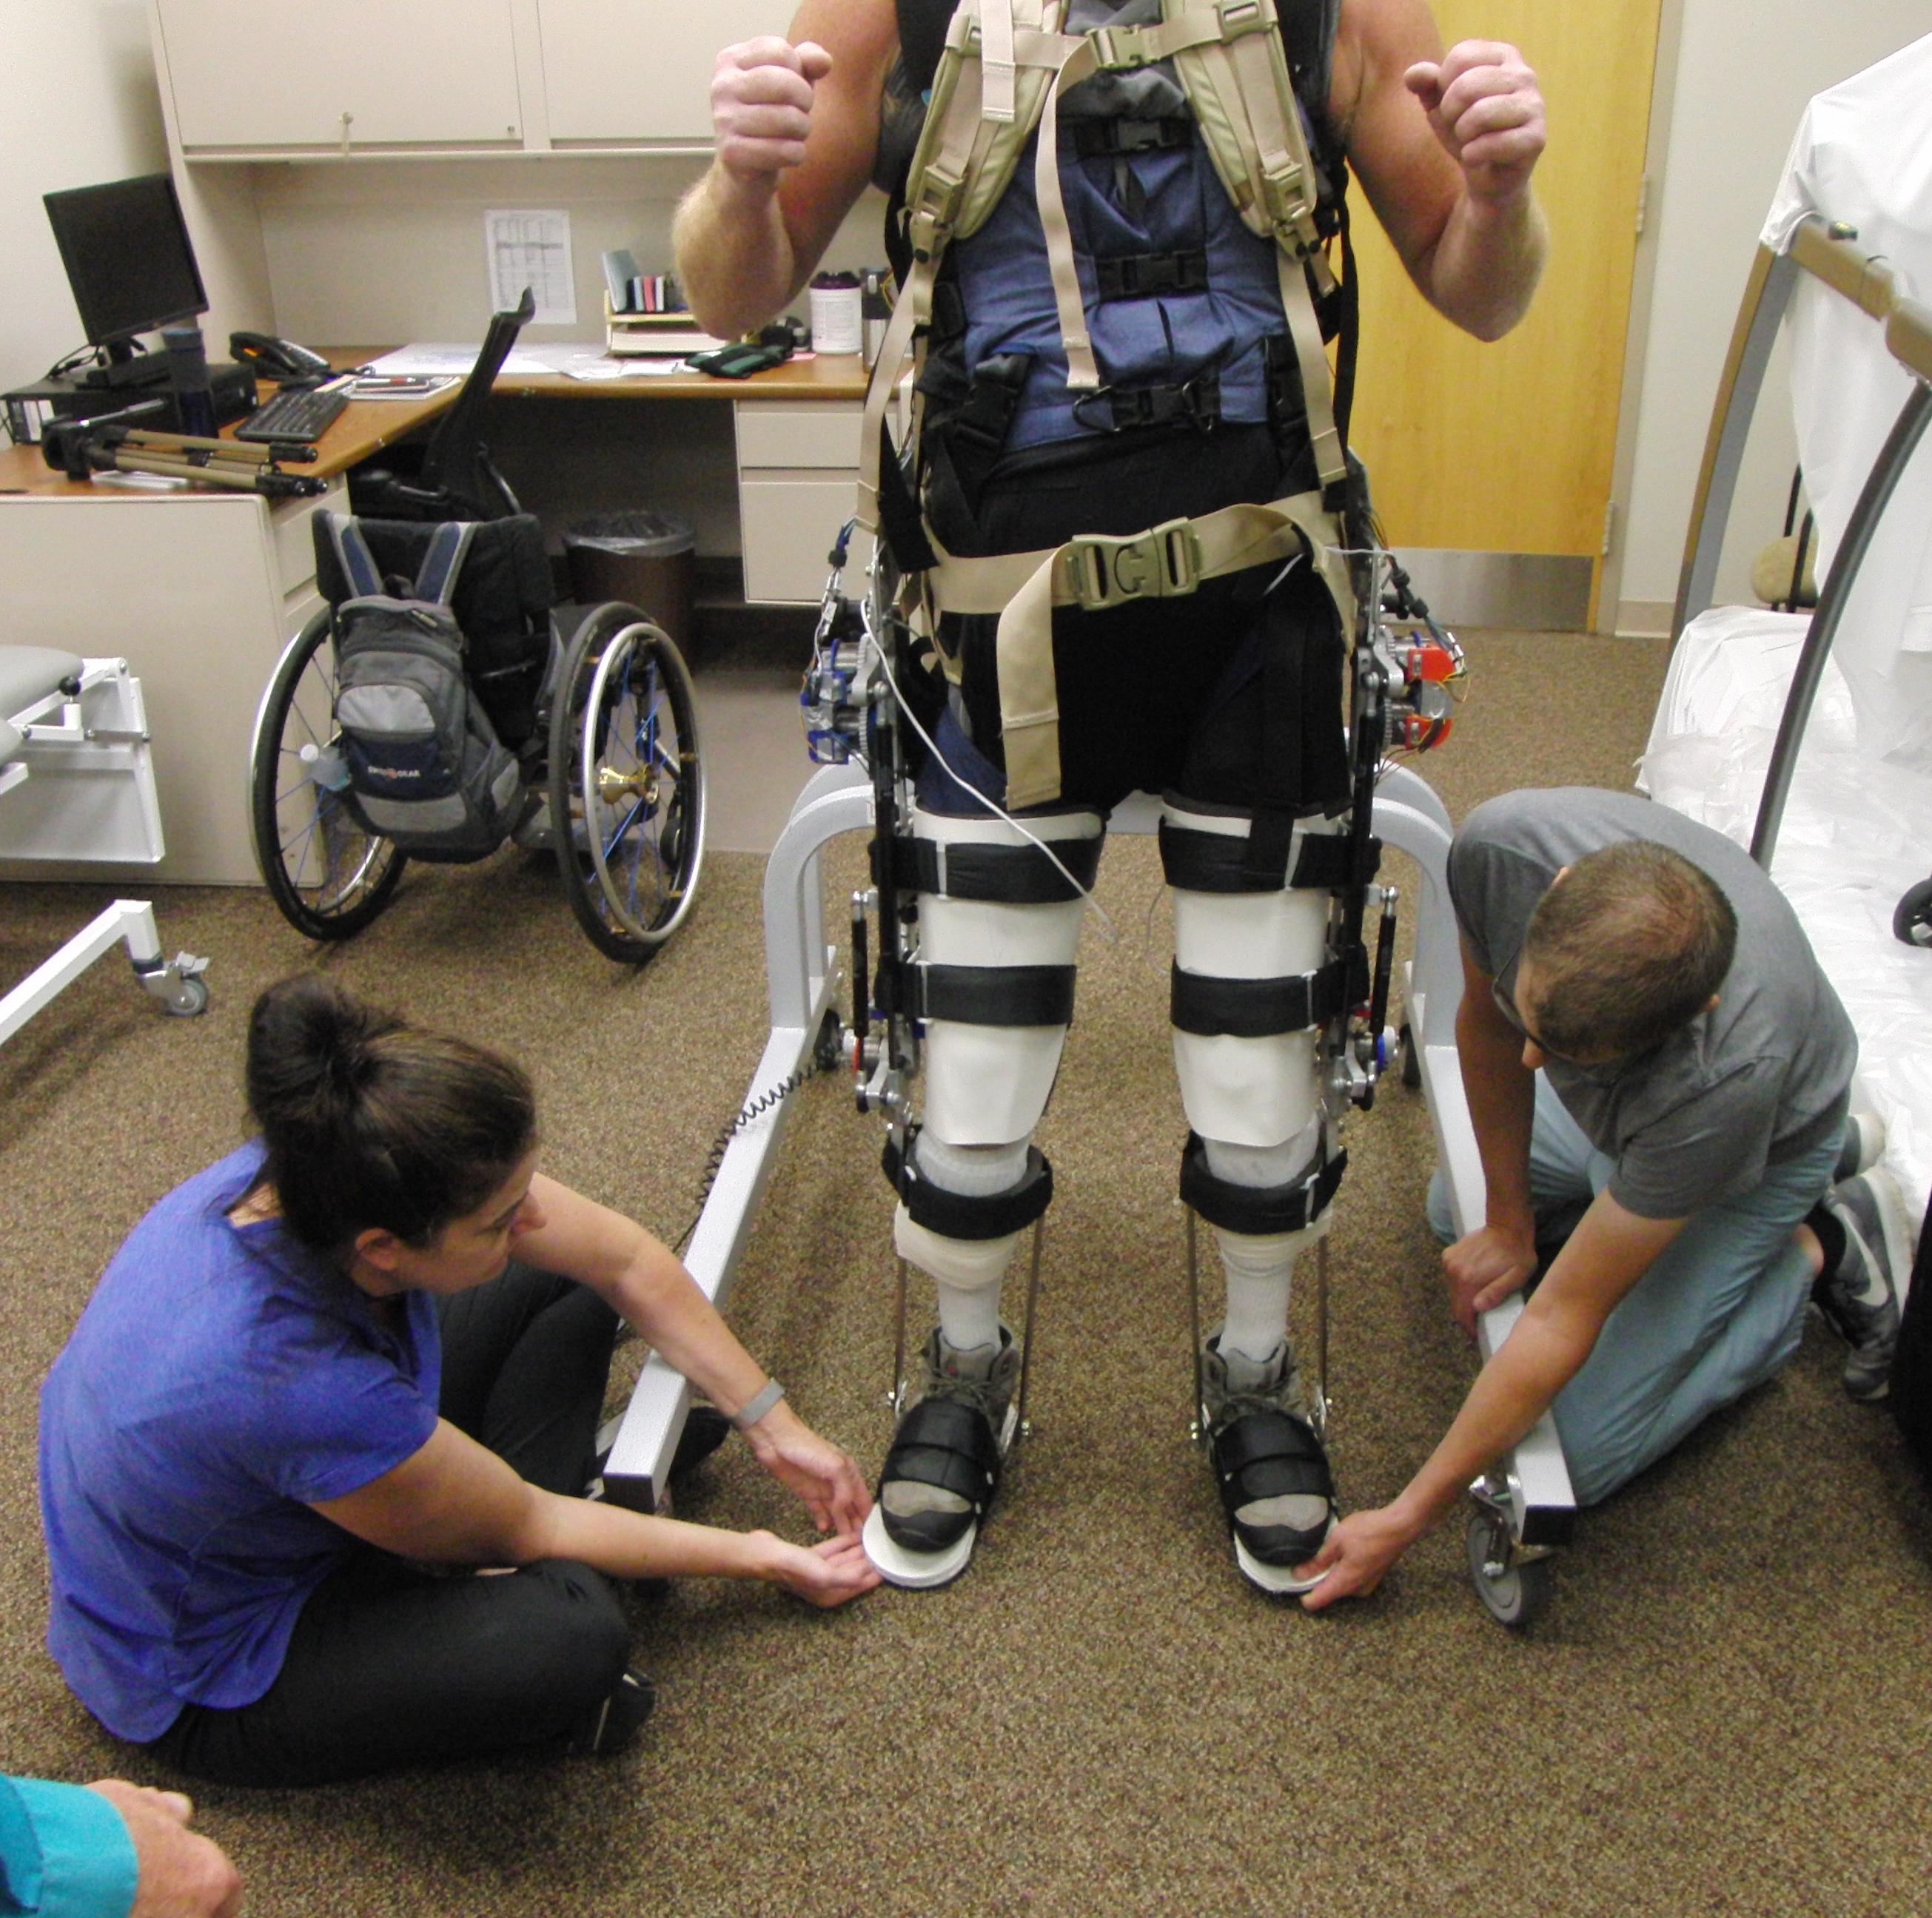
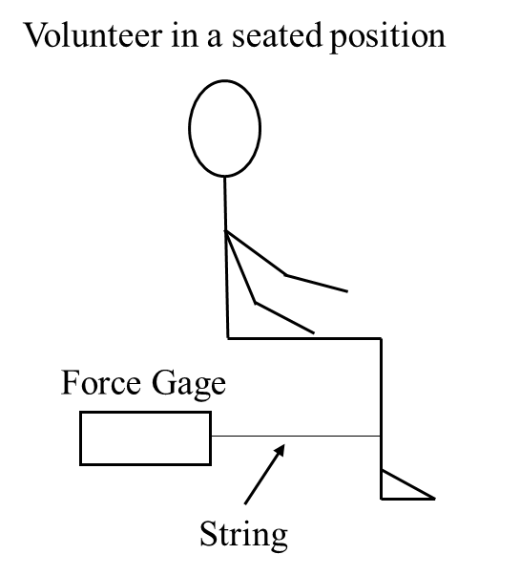
Preliminary user tests
Notes:
The FES-ESO was tested on one volunteer with SCI to determine the feasibility of the concept. Fit of the exoskeleton, standing posture, and stepping were to be evaluated.
FES torque tests were conducted on the volunteer’s leg to determine the peak quadriceps torque. The setup is shown in the figure on the right. The volunteer would be in a seated position, the electrodes were then placed on his quads at appropriate locations.
A Velcro strap with a string was then strapped to the user’s shank at 30 cm below the knee joint. The string was connected to the hook of the force gage which was held stationary by a person seated behind the volunteer’s leg (Figure 3.8). When the quadricep was stimulated, the knee tends to extend but the force gage prevents it from doing so and records the maximum force. The maximum force multiplied by the moment arm, which in this case was 30 cm, gives the peak torque. The peak quad torque measured was 34 Nm
During gait testing sessions, first, the electrodes were placed on the volunteer’s legs. Then the volunteer donned the exoskeleton
, the volunteer stood up with the assistance of the physical therapist and parallel bars. The locking of hip and the knee spring plungers was verified before allowing the volunteer to weight bear through the exoskeleton. Once a stable standing posture was achieved, the GUI would be used to test the stepping sequence.
The exoskeleton fit the volunteer. The joints of the exoskeleton aligned with the joints of the user’s body

Slide 38
Most design requirements met
Notes:
The measured values met the design requirements with the exception of don/doff time and weight of the device.

Slide 39
Prototype improvements
Problem | Proposed solution
Spring plunger unlocking while weight bearing | Replace rotational hard stops with actuated hard stops
Flexion at the knee, wrap spring slip after each load unload cycle | Non-backdrivable motor at hip and gas spring at knee, ratchet brake at knee
Notes:
Testing on a volunteer with SCI brought to light some problems with the current design.
The force required to manually pull the spring plunger to go from sit to stand was very high during weight bearing due to friction between the plunger and the hole into which it latched
The volunteer was able to stand in the exoskeleton with the support of parallel bars. However, the body attachment parts on the exoskeleton permitted some movement of the volunteer with respect to the exoskeleton. This resulted in flexion at the knee and as a result, the volunteer couldn’t maintain an upright posture. The wrap spring brake slipped by a few degrees with each load/unload cycle which lead to more flexion. Since people with SCI have atrophied muscles and weak bones, it was deemed unsafe for the volunteer to stand with a flexed knee. As a result, stepping tests couldn’t be performed
The non-backdrivable motor eliminates the need for a wrap spring brake at the hip and reduces the FES torque requirement. The gas spring at the knee retains the FES component of the device which helps prevent muscle atrophy. Replacing the wrap spring brake at the knee with a ratchet brake would eliminate the problem of wrap spring slip and help attain an upright posture.

Slide 40
Conclusions
The FES-ESO met most design requirements
Testing using a non-impaired individual demonstrated that the energy transfer component of the device worked
Volunteer’s quadriceps could provide the required torque to store energy in the gas springs
There is relative movement between the volunteer’s body and the structure of the exoskeleton
Wrap spring brakes locked the joints but slipped by a few degrees after each load-unload cycle
Notes:
Reduce words -

Slide 42
Backup slides

Slide 43
Prescribed angles during each phase of gait

Slide 44
Recommendation
Use a non-backdrivable motor at the hip and a gas spring at the knee
Replace rotational hard stops with actuated hard stops
A ratchet brake at the knee
Notes:
The recommendation is use a non-backdrivable motor at the hip and a gas spring at the knee for the next version of the device. The non-backdrivable motor eliminates the need for a wrap spring brake at the hip and reduces the FES torque requirement. The gas spring at the knee retains the FES component of the device which helps prevent muscle atrophy.
Replacing the rotational har stops with actuated hard stops would eliminate the need for a spring plunger to go from sit to stand
Finally, replacing the wrap spring brake at the knee with a ratchet brake would eliminate the problem of wrap spring slip and help attain an upright posture.

Slide 45

Exponential dependence on frictional coefficient
Exponential dependence on frictional coefficient
Gripping Torque
$$T_{g}=EIR∗\frac{\left(r−r_{0}\right)}{\left(r_{0}∗r^{2}\right)}∗(e^{2πNμ} −1)$$
Notes:
The theoretical coefficient of friction ranges from 0.4 to 0.5 which means that theoretically the gripping torque is 3.7*10^6
But oil on the discs will lead to a drop in coeff of friction to 0.1 which reduces the Tg to 13 Nm this is because of the exponential dependence of tg on friction

Slide 46

30 lbs ETS can compress 30 lbs HS

Slide 47

HS of 30 lbs can flex the hip to 10 deg wrt gravity

Slide 48

15 lbs KS, 30 lbs HS and ETS combination needs 23 Nm of FES torque

Slide 49


Fitting Session

Slide 50


Calf attachment

Slide 51
Prescribed angles for the FES-ESO gait cycle

Slide 52
Angle vs time for hip extension
This phase took 1.43 sec
Knee angle remained constant around 11 deg
Hip angle changed from 2.3 deg to -26 deg

Slide 53
Angle vs time for back to equilibrium
This phase took 0.87 sec
Knee angle changed from 11.5 deg to 59 deg
Hip angle changed from -12.5 deg to 13.8 deg

Slide 54



Working principle of gas springs
Gas Spring
Notes:
A gas spring is basically a system consisting of a pressure tube, rod and piston.
The energy for the spring is provided by gas at high pressure
The whole system is self contained and sealed against loss.

Slide 55

Working principle of gas springs
Notes:
1.2-1.4
Gas spring closed system, which means when the rod is pushed into the body pressure increases as the rod occupies some volume

Slide 56

Working principle of gas springs
Notes:
70lbs gas spring on mcmaster
Compression force listed 90lbs

Slide 57


Slide 58


Slide 61
Two limitations of FES-adied gait
systems are rapid muscle fatigue and the inability to precisely control the stepping motion
Notes:
Ability to walk using own muscle enhances functional mobility and also muscle and bone health
In addition, bone disuse for people with SCI leads to bone loss, which
results in up to 60% of bone mineral density (BMD) and doubling of the risk for bone fracture
when compared to the regular population [7, 8, 9, 10, 11].

Slide 62


Slide 63



Some geometrical considerations for motor attachment
Angular rotation required to disengage spring = 11°
Projected arc length = R*sinθ = 4.6 mm
Same projected length for motor:
r*sinα = 4.6 mm (where α is the rotation of motors shaft)
α = 45.04°
Control tang moves in an arc:
Clearance required = r-rcosα =1.9 mm
Notes:
Axis of the wrap spring and that of the motor re perpendicular to each other

Slide 64

Angle between the ends of the spring
Unmounted Spring:
r = 21.3995 cm
n = number of coils = 13.5
Coiled length of spring = 2*π*r*n = 1781.55 cm
Each revolution = 2*π*r = 134.457 cm
Mounted Spring:
R = 21.3995 cm
Coiled length of spring = 1781.55 cm
Each revolution = 2*π*R = 138.8458 cm
Number of revolutions on shaft = coiled length/each rev = 12.8311
Angle between the ends of the spring = 0.1689*360° = 60.804°
Fig 14: Wrap Spring- ends of unmounted spring are at 90deg relative to one another
Notes:
N- no of coils
Relative angular position of the two ends of the spring

Slide 65


Slide 66


