Slide 1
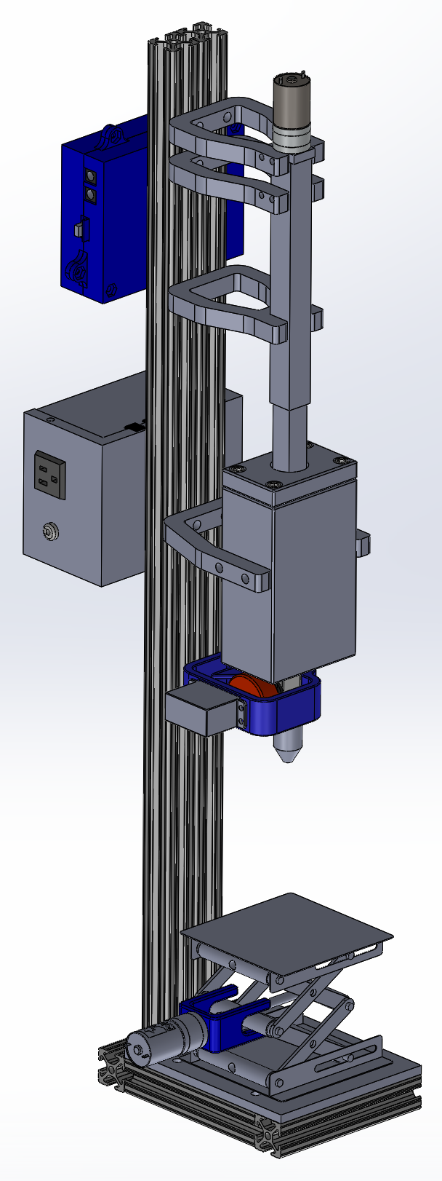
Mini Molder
Vikram Katti
Jarrod Neuharth
12/18/17

Slide 3
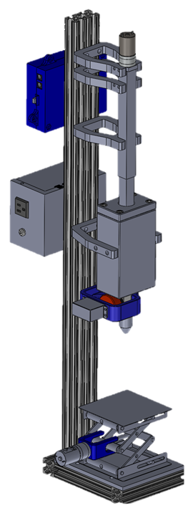
Linear actuator
PCB enclosure
Heater block
High voltage enclosure
Servo valve
Scissor jack
Frame

Slide 4
Linear actuator
PCB enclosure
Heater block
High voltage enclosure
Servo valve
Scissor jack
Frame

Slide 5
Linear Actuator
Shaft coupler
Motor
Piston
Nut
Threaded rod
Inner tube
Connector plate
Outer tube

Slide 6
Linear actuator
PCB enclosure
Heater block
High voltage enclosure
Servo valve
Scissor jack
Frame

Slide 7
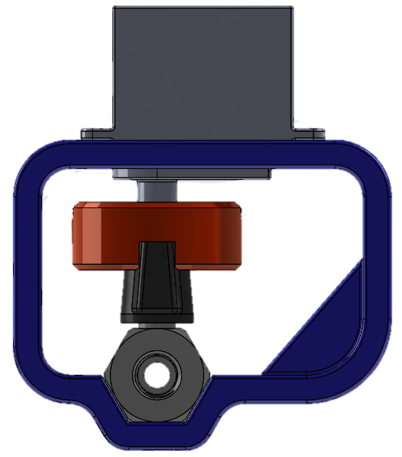
Servo Valve
Servo motor
Coupler
Frame
(UHMW)
Ball valve

Slide 8
Linear actuator
PCB enclosure
Heater block
High voltage enclosure
Servo valve
Scissor jack
Frame

Slide 9
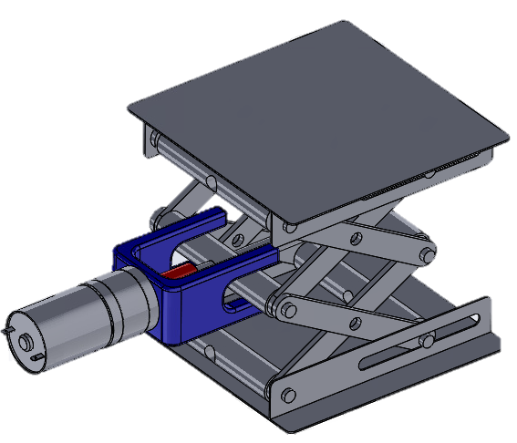
Scissor Jack
Jack stand
Motor mount
Shaft coupler
Motor

Slide 10
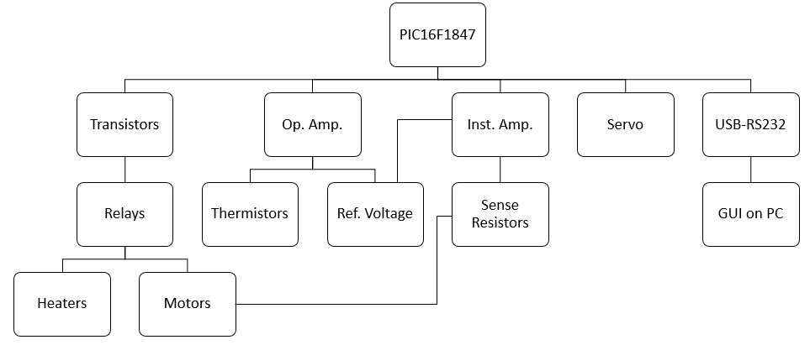
Electrical System

Slide 11
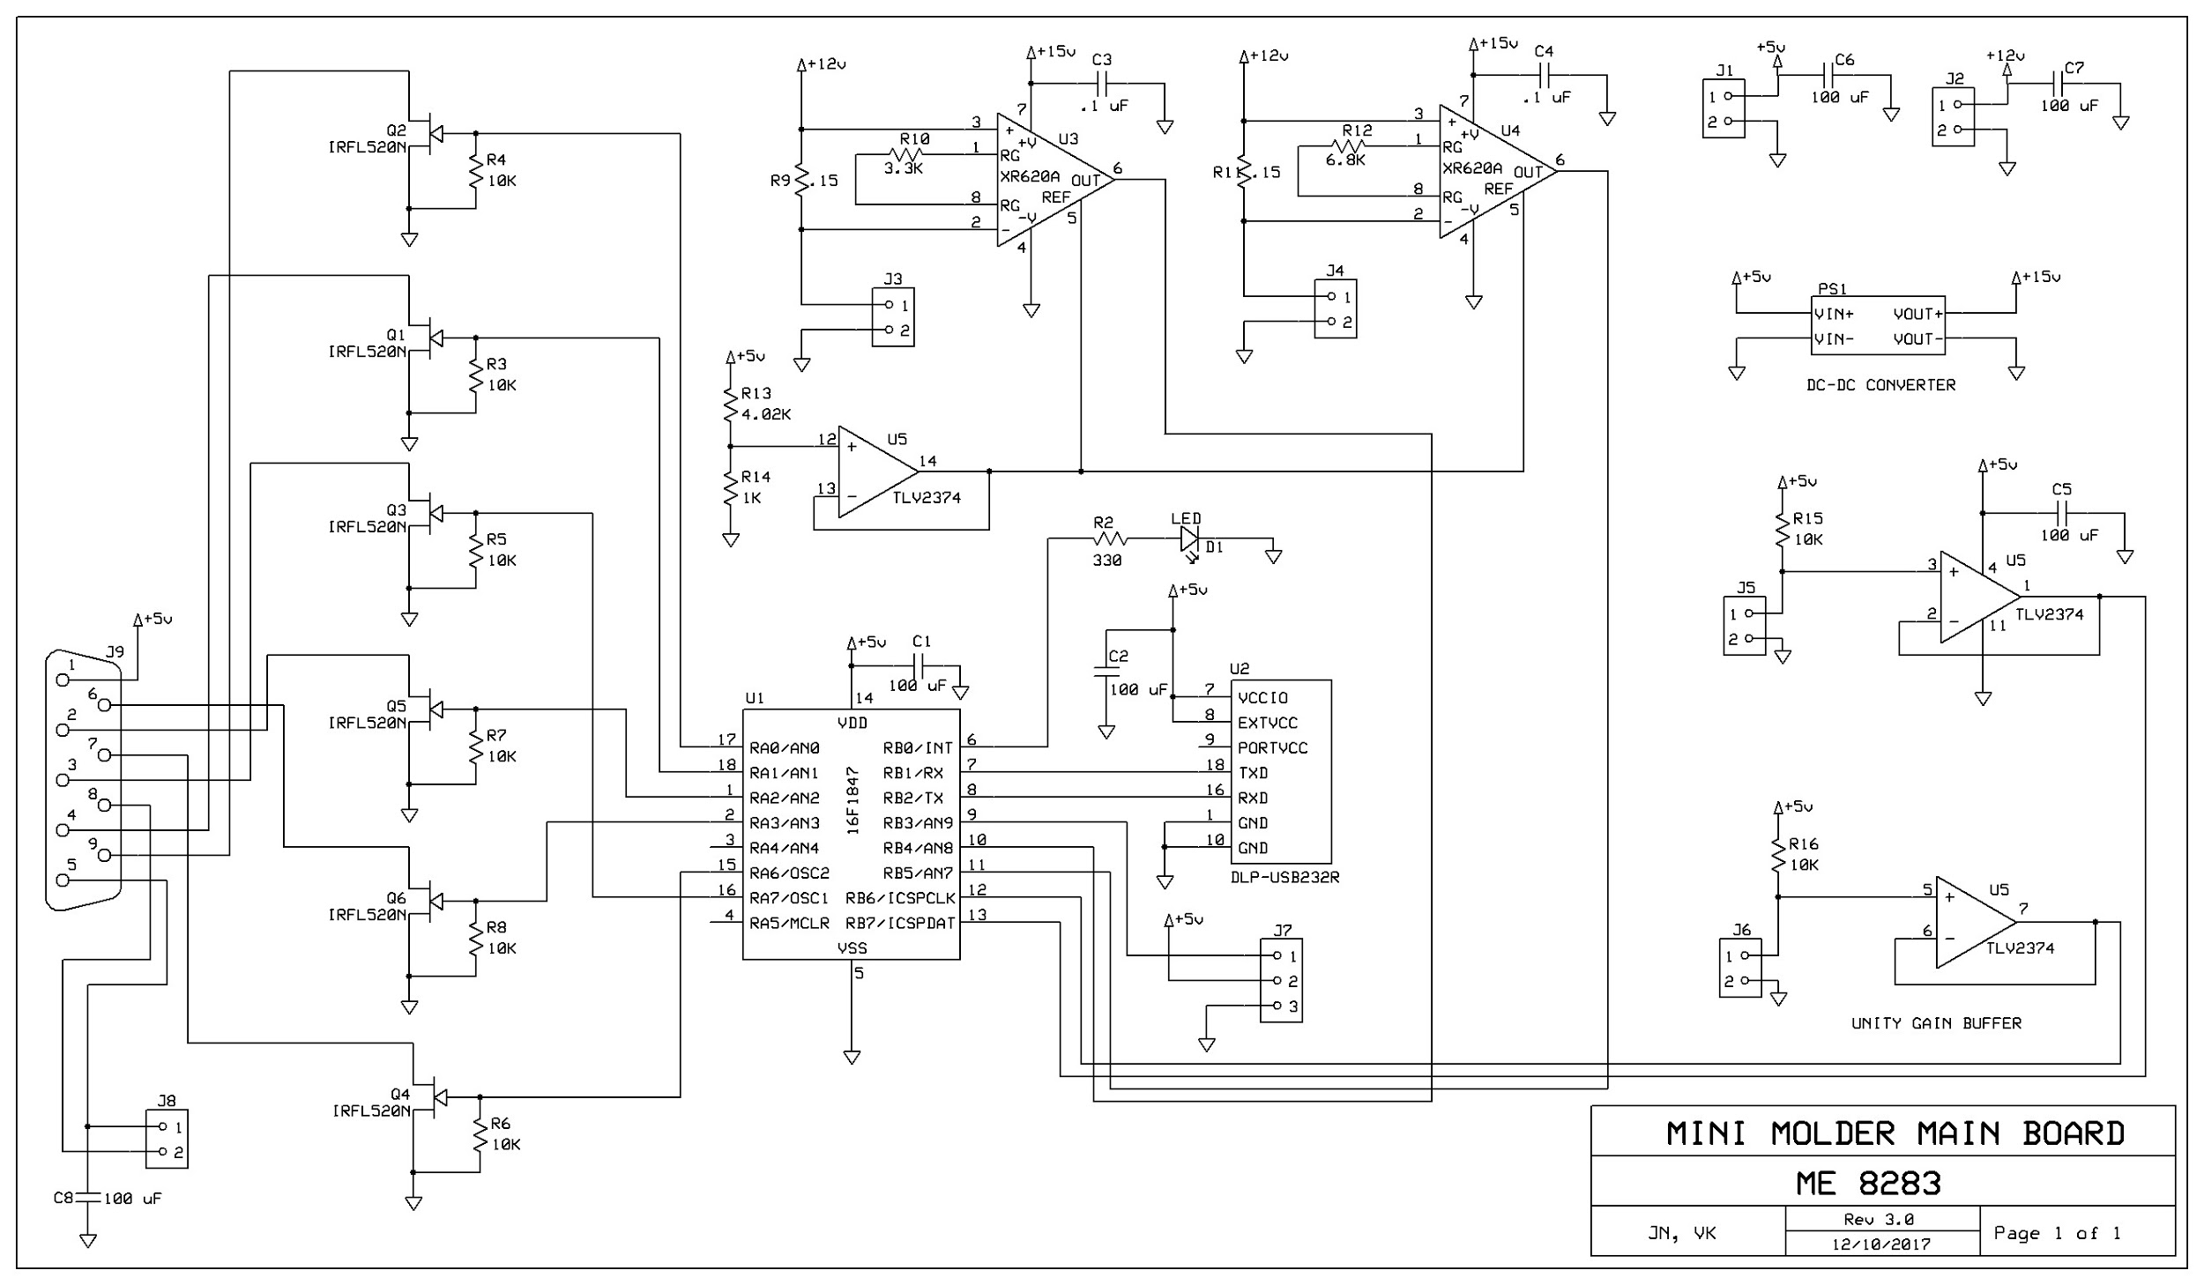

Slide 12
Transistors to pull relays to ground

Slide 13
Motor current acquisition

Slide 14
Temperature acquisition

Slide 15
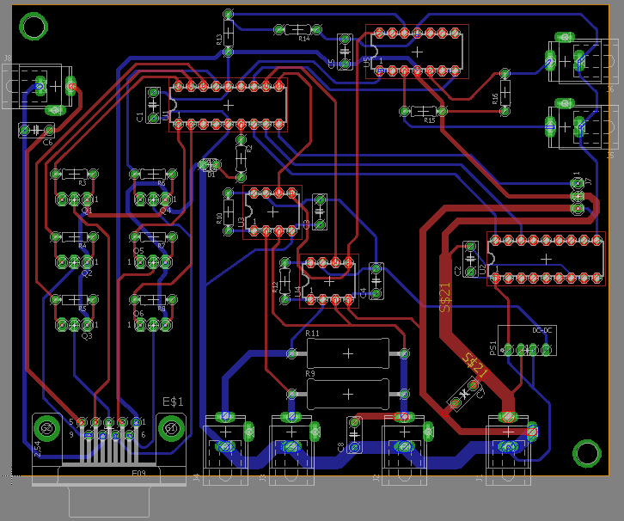

Slide 16
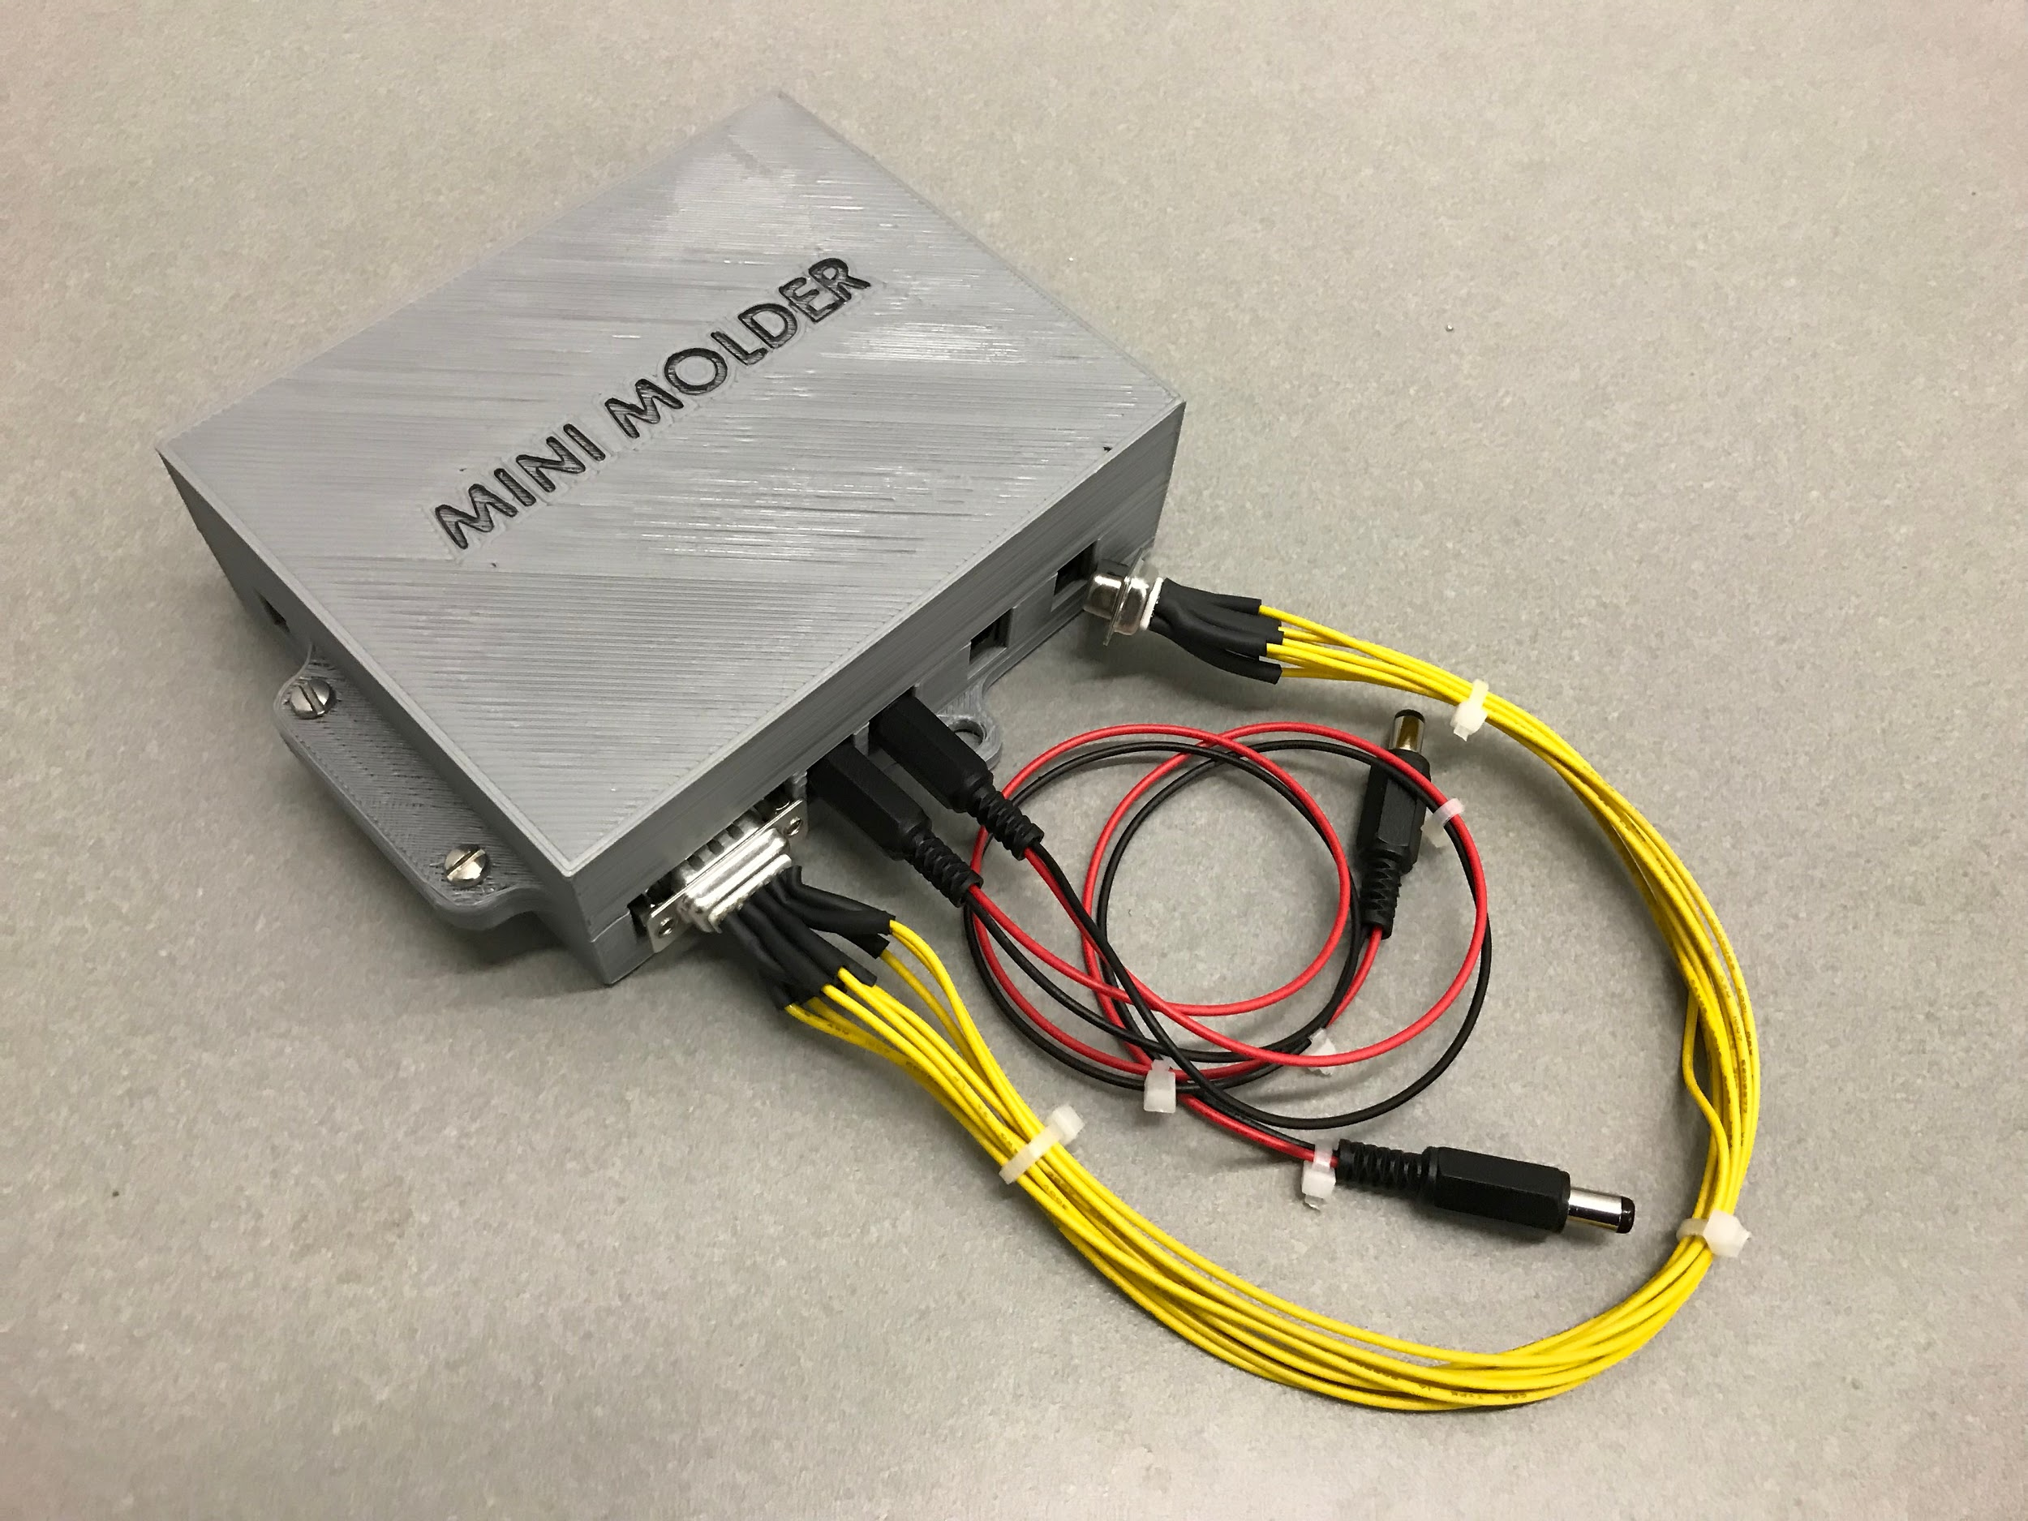
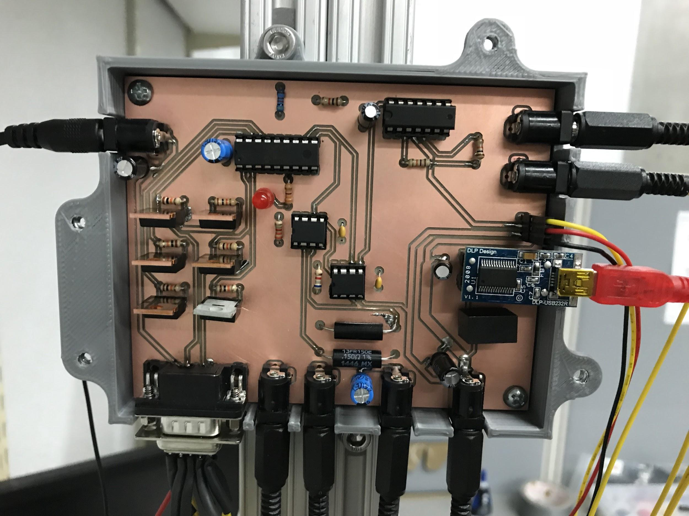
PCB Enclosure

Slide 17
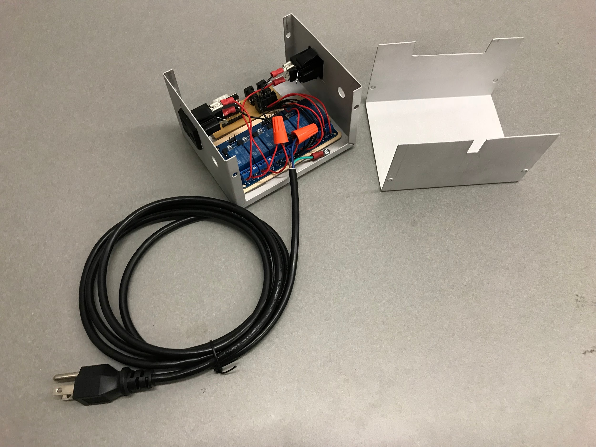
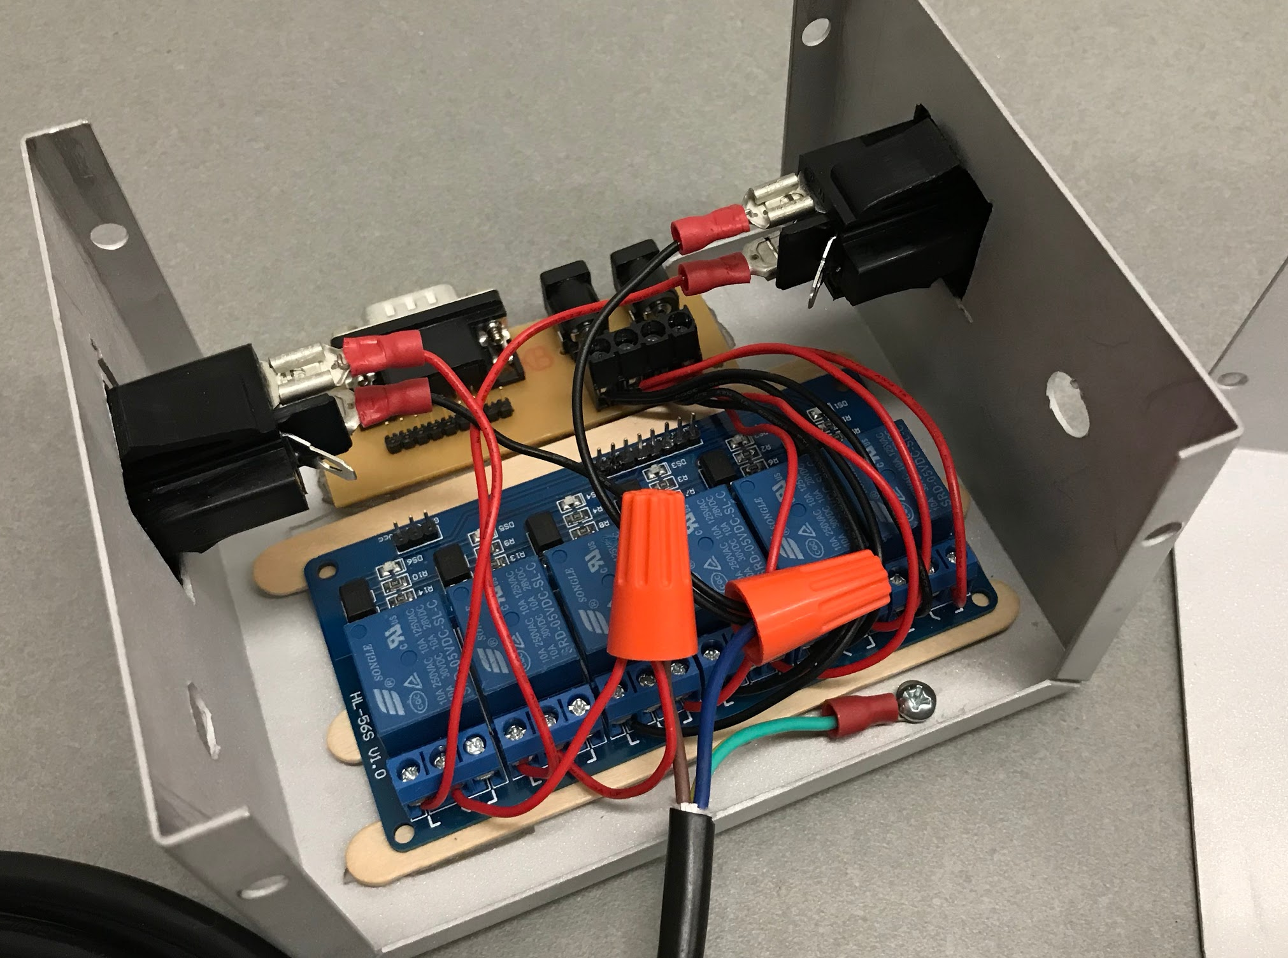
High Voltage Enclosure

Slide 18
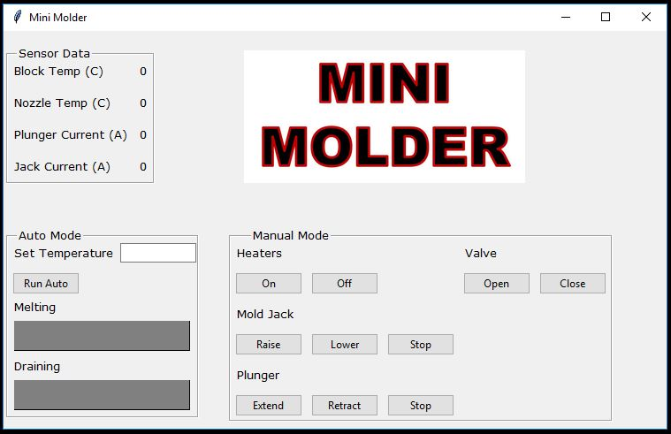
GUI

Slide 19
